Slide 1
Business Office Tutorial

Slide 2
Business Office Tutorial
Reviewing Departmental Budget using Banner
Purchase Requisition
Voucher
Budget Transfer Form
Preferred College Vendors
Sales Tax
Mileage Reimbursement

Slide 3
Reviewing Departmental Budget using Banner (FGIBDST)
Budget information can be accessed and reviewed in Banner on the Budget Status Report, FGIBDST form.
Six Sections to the Form:
  Account Number
  Account Title
  Adjusted Budget (Original Budget including Budget Transfers, if applicable)
  YTD Activity (Purchase Orders and Vouchers Paid to date)
  Commitments (Purchase Orders not yet paid)
  Available Balance (Adjusted Budget less YTD Activity less Commitments)

Slide 4
Reviewing Departmental Budget using Banner (FGIBDST)
Query section of Form:
  Fiscal Year (16 = 1516 academic year 17 = 1617 academic year)
  Organization (Enter Department Number)
  Fund (1110)
  Account
    Enter Account Number to only see that account
    Leave blank to see all account numbers for your department
  Account Type
    61 for Salaries
    69 for Benefits
    72 for Contract Services
    71 for Capital Equipment
    Leave blank to show all expense categories

Slide 5
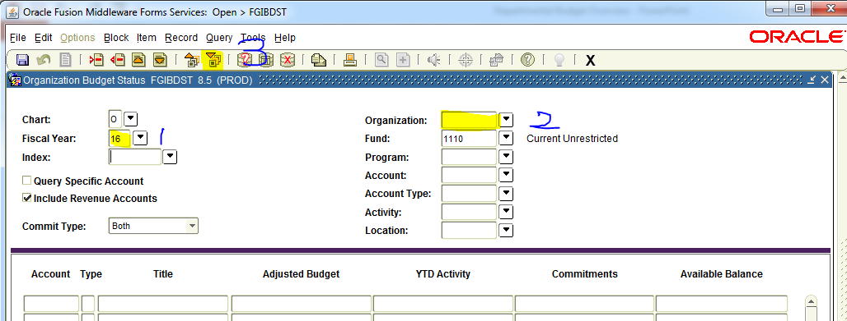
Reviewing Departmental Budget using Banner (FGIBDST) (Running a Departmental Query)

Slide 6
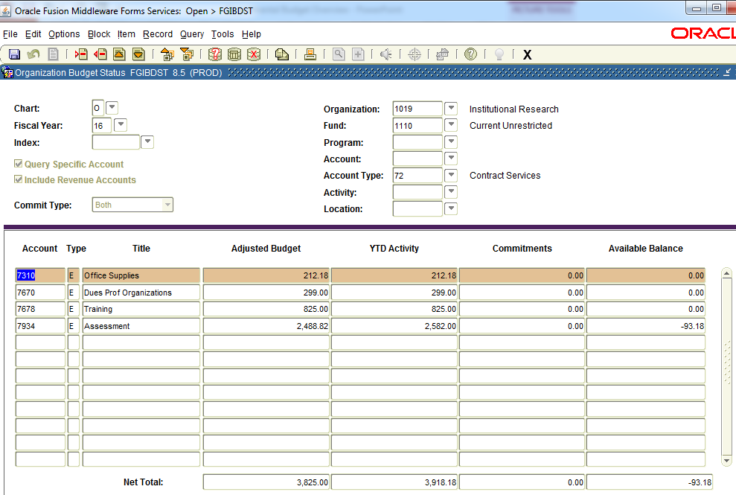
Reviewing Departmental Budget using Banner (FGIBDST) (Query Output)

Slide 7
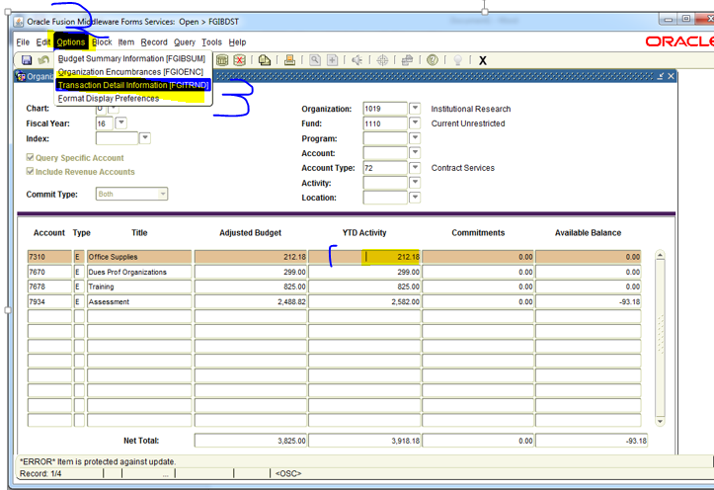
Reviewing Departmental Budget using Banner (FGIBDST) (View Detail of an Expense Line)

Slide 8
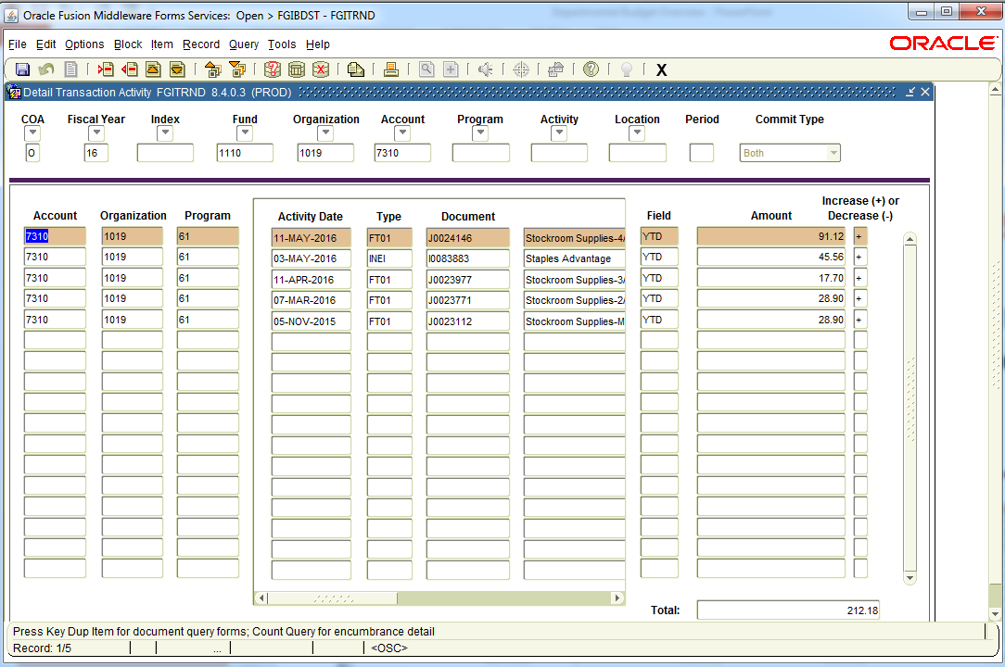
Reviewing Departmental Budget using Banner (FGIBDST) (Output of Detail of the Expense Line)

Slide 9
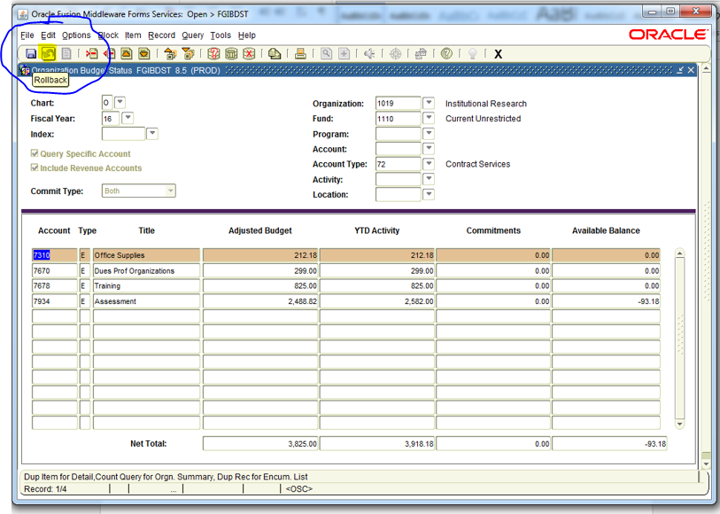
Reviewing Departmental Budget using Banner (FGIBDST) (How to initiate new query?)

Slide 10
Purchase Requisition

Slide 11
Purchase Requisition
Purchasing Guidelines
  Greater or Equal to $5,000 should have three quotes
  Greater or Equal to $20,000 should be Bid, RFP, or etc. (Contact Purchasing Dept)
  Greater or Equal to $35,000 Sealed Public Bid (Contact Purchasing Dept)

Slide 12
Steps to Completing a Purchase Requisition Successfully
Check your department's account balance to make sure there are funds available.
  If funds are not available, validate if you have funds available elsewhere in your departmental budget. If so then complete a Budget Transfer Form and submit this with your Purchase Requisition. The Appropriation Transfer Form can be found on the Business Office’s Purchasing Department link on the employee portal.
Obtain quotes as required.
  Only exception to this rule is if a vendor and the item being ordered is on state contract. If so you always have the ability to negotiate the price for less, and must enter state contract number on the Purchase Requisition.
Confirm the Vendor accepts a Purchase Order to initiate the order process.

Slide 13
Steps to Completing a Purchase Requisition Successfully
The following fields must be entered on a Purchase Requisition prior to submitting it to the Purchasing Department.
  Contact Person Name, phone, fax, email and address
  Vendor Name
  Department Number
  Account Number
  Unit Price
  Quantity
  Description of the item with an item number, and any other necessary information needed to place the order.

Slide 14
Steps to Completing a Purchase Requisition Successfully
The Purchase Requisition must be signed by the departmental supervisor and dated. Please print names when signatures are not legible.
  If purchases are related to IT software and hardware purchases or the College Logo, an additional signature is needed from either the CIO or Marketing Department Personnel prior to submitting the requisition to Purchasing.
On a side note; we are asking all departments to wait on placing a Staples Purchase Requisition until they have a minimum order of $20.00, and to check with the College Stockroom first prior to completing the purchase requisition.

Slide 15
Sequence of Events from a Purchase Requisition to Paying the Vendor
Department completes and submits a Purchase Requisition with supporting documentation to the Purchasing Department.
  Purchase Requisitions should Never be sent to a Vendor.
Purchasing Department creates a Purchase Order after validating that the purchase requisition was completed correctly, and all proper documentation submitted.
Copies of the purchase order are sent to the following:
  The Vendor
    This acts as a contract between the college and the vendor
  The Department initiating the request
  Accounts Payable
  If applicable, Receiving Department

Slide 16
Sequence of Events from a Purchase Requisition to Paying the Vendor
Goods and/or Services are provided to the college by the vendor.
Vendor submits an invoice to the college.
The Department initiating the purchase request validates the accuracy of the invoice.
Once the invoice is reviewed and approved for accuracy, then the department signs, dates, and states ok to pay on the invoice.
The approved invoice is then sent to Accounts Payable.
Accounts Payable matches the invoice, to the purchase order, and if applicable the Receiving copy of the purchase order.
A check is cut to the vendor.

Slide 17
Voucher

Slide 18
Vouchers
Vouchers are primarily for services such as membership and subscriptions or reimbursements such as mileage reimbursement and must be submitted to the Business Office by Friday for payment the following week.
All Vouchers must have proper department authorization and supporting documentation for payment to be made.
Individuals can not approve their own reimbursement voucher. It must be authorized by the individuals supervisor.
Some Vouchers may require a W-9 if payment is made to an individual.

Slide 19
Vouchers
The following fields must be entered on a Voucher prior to submitting it to the Business Office.
  Voucher Date
  Vendor Name
  Vendor Address
  Detailed Description
  Account Number
  Price
The completed Voucher must have all original supporting documentation attached to it such as invoice or cash receipt.

Slide 20
Budget Transfer Form
This form must be completed if insufficient funds are available in a budget line, or you expect to have future insufficient funds in a budget line.
Departmental approval is required by the Departmental Supervisor and Comptroller.
Transfer form should be submitted with the Purchase Requisition or Voucher Form.
Budget transfers cannot be made from salary budget lines beginning with a “6” such as ex. 6501.

Slide 21
Preferred College Vendors
The college has preferred vendors, please use them when applicable.
  Staples for office and instructional supplies.
    Log into https://www.staplesadvantage.com to see all contract priced supplies.
    New employees are to call Purchasing Department to establish login.
    Go to http://www.staples.com/ to see a listing of all supplies, and if an item is found here and is not found using https://www.staplesadvantage.com , then call Purchasing.
  Enterprise for vehicle rental
  Shop Rite
  Panera (aka: Take Home the Bread),Franco Di Roma, Lorenzo Group for approved college events.
    Student event food/beverage purchases are limited to once a year per department.
    No Food/Beverage purchases for employee related meetings.
      The only exception is if a meeting is 4 hours or longer and occurs during lunch time.
        If possible these meeting should be scheduled either early morning or late afternoon to avoid lunch time.
        This exception should be a rarity.
    Cost Guideline: Cost for food and beverage for an approved college event should not exceed $10 a person.
    Voucher Form should have date, time span, description, number of attendees of event, and if it was a student or employee event.

Slide 22
SALES TAX
The College is exempt from paying New York State sales tax.
Provided to a vendor prior to making a taxable purchase.
Found on the Business Office Website.
There will be no reimbursement for any NYS sales tax that has been paid.

Slide 23
Mileage Reimbursement
SUNY Orange will only reimburse employees the most cost-effective mode of transportation that is directly related to their work duties.
  A Travel Reimbursement Form needs to be completed to determine if renting or usage of personal vehicle is the most cost-effective mode of transportation.
  Travel Reimbursement Form is located on the Business Office portal.

Slide 24
Mileage Reimbursement
Mileage rate is currently reimbursed at a rate that is determined by the IRS.
  The current rate, as of January 1, 2017, is $0.535 cents per mile. This rate is traditionally adjusted each January and notice of changes will be posted on the Business Office web site and the Grapevine.
The mileage for trips to the Newburgh campus is 28 miles for a one way trip and 56 miles for a round trip.
  All other trips must have a mapquest document attached to the Reimbursement Voucher.
Mileage Reimbursement Forms should be submitted to the Business Office on a monthly basis, if applicable.

Slide 25
Purchasing Questions
Information is available on the Business Office website.
  Purchase Requisitions: SUNY Orange: Business Office - Purchase Requisition
  Vouchers: http://sunyorange.edu/businessoffice/voucher.shtml
  Budget Transfer Form: http://sunyorange.edu/businessoffice/docs/appropriation_transfer_form.xlsx
  Sales Tax Exempt Form: http://sunyorange.edu/businessoffice/docs/tax_exempt_certificate.pdf
  Mileage (Travel) Reimbursement Form: http://sunyorange.edu/businessoffice/docs/TravelReimbursement_5.xlsx
Call Maria Sarett ext 4852 or Renee Arnold at ext 4780

