Slide 1
Business Office Tutorial

Slide 2
Business Office Tutorial
Tentative Budget Development Schedule
Reviewing Departmental Budget using Banner
Purchase Requisition
Voucher
Budget Transfer Form
Preferred College Vendors
Sales Tax
Mileage Reimbursement

Slide 3
Tentative Budget Development Schedule
October to November - Department and Unit Managers develop AY 17/18 annual goals, outline actions steps, and determine resources needed. Enter goals, action steps, and resources into PIP.
AVPs/VPs develop area AY 17/18 goals, action steps, resources needed after thorough review of department/unit PIP submittals.
December – Creation of Baseline Budget Model by Business Office.
Baseline Budget Model is a rollover of prior year original budget, adds contract salary increases, health benefit increases, operating expense increases (utilities, contracts, agreements, supplies, and etc.), known budget increases found during the current academic year, new program support costs, dollar amount for strategic initiatives, and faculty promotions. Other items that are included in the Baseline Budget is future student enrollment and possible tuition increase.
January – Half-day Cabinet retreat to review division goals, actions steps, and resources needed.
January – Cabinet identifies strategic priorities.
January – Create Executive Summary of Institutional Strategic Priorities (to communicate college-wide).
January to March – Discussion on closing budget gap in baseline budget, finding dollars to apply to strategic initiatives, reallocation of budget dollars within departmental budgets, and discussion of what to do if State Budget expectations are not met.
Schedule 2-3 Budget Forums for faculty, staff, and student participation facilitated by PBIE. Budget Forums will include brief financial highlights, review of baseline budget & key assumptions, review Executive Summary of Institutional Strategic Priorities, break out into roundtables for discussion, feedback, cost saving ideas, alternative funding sources, etc.
Banner is updated with Contract Services Baseline Budget.
March – Board approves Tuition and Fee Schedule for next academic year.
April – President/VPs/Cabinet balance budget.
April – Expectation that the State Budget is passed timely.
May – Board of Trustees approves budget. Upon approval complete compilation of Budget Documentation to be viewed and disseminated to County , County auditors, and college community.
May – Closure – President follows up with campus communication that summarizes the process, forums, input, and results. Thanks all for participation in planning/budgeting process.
May – Banner is updated with approved budget.
Late May – Submit Budget Request Booklets to County and gather data needed for auditors.
Late May into early June – County audit team arrives on campus.
July – County Auditors communicate to County completion of audit, so then Public Hearing, Legislature Committee Meeting (presentation by auditors), and Full Legislature Vote on budget can be put on County Calendar.
September 1st – New budget year begins.

Slide 4
Reviewing Departmental Budget using Banner (FGIBDST)
Budget information can be accessed and reviewed in Banner on the Budget Status Report, FGIBDST form.
Six Sections to the Form:
  Account Number
  Account Title
  Adjusted Budget (Original Budget including Budget Transfers, if applicable)
  YTD Activity (Purchase Orders and Vouchers Paid to date)
  Commitments (Purchase Orders not yet paid)
  Available Balance (Adjusted Budget less YTD Activity less Commitments)

Slide 5
Reviewing Departmental Budget using Banner (FGIBDST)
Query section of Form:
  Fiscal Year (16 = 1516 academic year 17 = 1617 academic year)
  Organization (Enter Department Number)
  Fund (1110)
  Account
    Enter Account Number to only see that account
    Leave blank to see all account numbers for your department
  Account Type
    61 for Salaries
    69 for Benefits
    72 for Contract Services
    71 for Capital Equipment
    Leave blank to show all expense categories

Slide 6
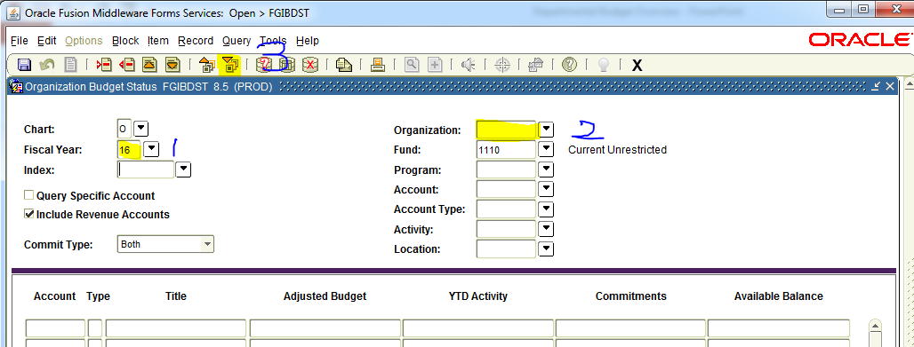
Reviewing Departmental Budget using Banner (FGIBDST) (Running a Departmental Query)

Slide 7
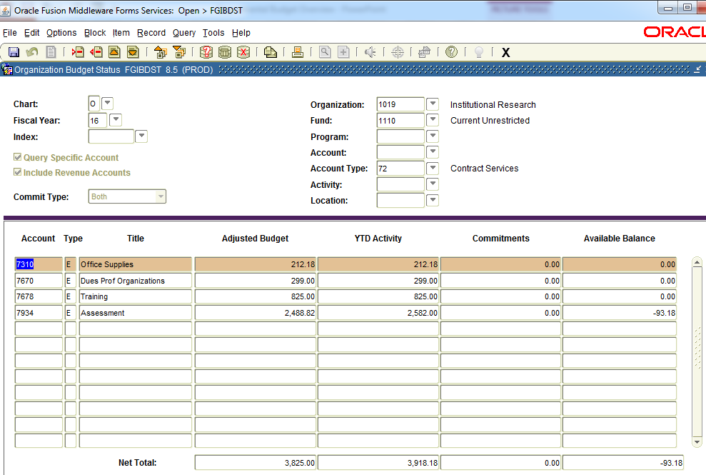
Reviewing Departmental Budget using Banner (FGIBDST) (Query Output)

Slide 8
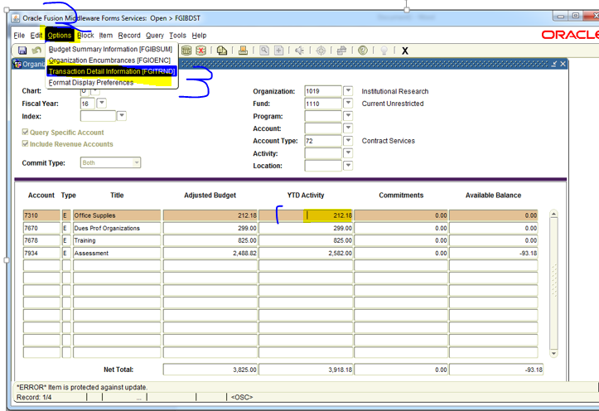
Reviewing Departmental Budget using Banner (FGIBDST) (View Detail of an Expense Line)

Slide 9
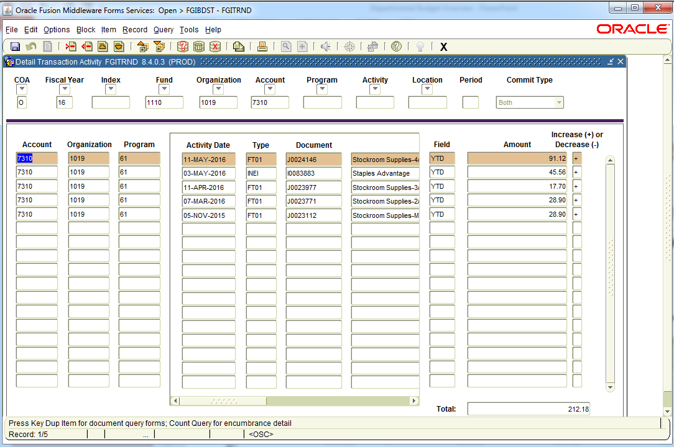
Reviewing Departmental Budget using Banner (FGIBDST) (Output of Detail of the Expense Line)

Slide 10
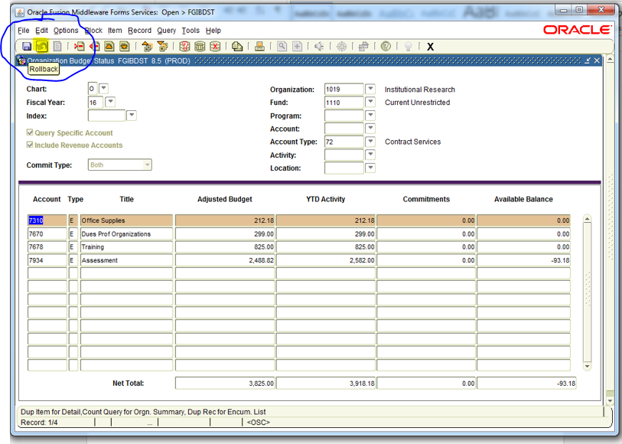
Reviewing Departmental Budget using Banner (FGIBDST) (How to initiate new query?)

Slide 11
Purchase Requisition

Slide 12
Purchase Requisition
Purchasing Guidelines
Steps to Completing a Purchase Requisition Successfully
Sequence of Events from a Purchase Requisition to Paying the Vendor

Slide 13
Purchasing Guidelines
Capital Equipment
Materials and Supplies
Contract Services

Slide 14
Purchasing Guidelines on Capital Equipment
CAPITAL EQUIPMENT - Is equipment lasting more than one year and each unit costs $500 or more.
$1,000 - $7,999 – Three verbal quotes required (obtained by Requisitioner). Verbal quote form to be completed and submitted with your requisition.
$8,000 - $19,999 – Three written quotes are required and to be obtained by the Requisitioner or the Purchasing Department where appropriate.
$20,000 – Over – Sealed, public bid required, responsibility of Purchasing Department. Requisitioner supplies the names of three vendors and specification sheet to identify equipment completely so all vendors will bid on same type of item. This is also applicable when capital equipment is purchased in aggregate.

Slide 15
Purchasing Guidelines on Materials and Supplies
MATERIALS AND SUPPLIES - Materials and supplies expendable within one year and costs under $500 per item.
$1,000 - $19,999 – Three written quotes required. Quotes obtained by Requisitioner or Purchasing Department. Requisitioner completes and submits the quote with the requisition.
$20,000 – Over – Sealed, public bid required. This is the responsibility of the Purchasing Department per General Municipal Law §103. Requisitioner is to supply names of three vendors and specification sheet, and identify equipment completely so all vendors will bid on same type of item. This is also applicable when materials and supplies are purchased in aggregate.

Slide 16
Purchasing Guidelines on Contract Services
CONTRACT SERVICES – “PUBLIC WORKS” that relate to most service contracts and is not limited to contracts for construction and building services. (FYI: Printing is not PUBLIC WORKS)
Up to $20,000 – Three written quotes required. Quotes are obtained by Requisitioner or Purchasing Department. Requisitioner completes and submits the quote with the requisition. Department may recommend Award. Contract Awarded at the discretion of the Purchasing Department.
$20,001 - $35,000 – Four written quotes required. Quotes are obtained by Requisitioner or Purchasing Department. Requisitioner completes and submits the quote with the requisition. Department may recommend Award. Contract Awarded at the discretion of the Purchasing Department.
Over $35,000 – Sealed, public bid per General Municipal Law §103.

Slide 17
Steps to Completing a Purchase Requisition Successfully
Check your department's account balance to make sure there are funds available.
  If funds are not available, validate if you have funds available elsewhere in your departmental budget. If so then complete an Appropriations Transfer Form and submit this with your Purchase Requisition. The Appropriation Transfer Form can be found on the Business Office’s Purchasing Department link on the employee portal.
Obtain quotes as required.
  Only exception to this rule is if a vendor and the item being ordered is on state contract. If so you always have the ability to negotiate the price for less, and must enter state contract number on the Purchase Requisition.
Confirm the Vendor accepts a Purchase Order to initiate the order process.

Slide 18
Steps to Completing a Purchase Requisition Successfully
The following fields must be entered on a Purchase Requisition prior to submitting it to the Purchasing Department.
  Contact Person Name, phone, fax, email and address
  Vendor Name
  Department Number
  Account Number
  Unit Price
  Quantity
  Description of the item with an item number, and any other necessary information needed to place the order.

Slide 19
Steps to Completing a Purchase Requisition Successfully
The Purchase Requisition must be signed by the departmental supervisor and dated. Please print names when signatures are not legible.
  If purchases are related to IT software and hardware purchases or the College Logo, an additional signature is needed from either the CIO or Marketing Department Personnel prior to submitting the requisition to Purchasing.
On a side note; we are asking all departments to wait on placing a Staples Purchase Requisition until they have a minimum order of $20.00, and to check with the College Stockroom first prior to completing the purchase requisition.

Slide 20
Sequence of Events from a Purchase Requisition to Paying the Vendor
Department completes and submits a Purchase Requisition with supporting documentation to the Purchasing Department.
  Purchase Requisitions should Never be sent to a Vendor.
Purchasing Department creates a Purchase Order after validating that the purchase requisition was completed correctly, and all proper documentation submitted.
Copies of the purchase order are sent to the following:
  The Vendor
    This acts as a contract between the college and the vendor
  The Department initiating the request
  Accounts Payable
  If applicable, Receiving Department

Slide 21
Sequence of Events from a Purchase Requisition to Paying the Vendor
Goods and Services are provided to the college by the vendor.
Vendor submits an invoice to the college.
The Department initiating the purchase request validates the accuracy of the invoice.
Once the invoice is reviewed and approved for accuracy, then the department signs, dates, and states ok to pay on the invoice.
The approved invoice is then sent to Accounts Payable.
Accounts Payable matches the invoice, to the purchase order, and if applicable the Receiving copy of the purchase order.
A check is cut to the vendor.

Slide 22
Voucher

Slide 23
Vouchers
Vouchers are primarily for services such as membership and subscriptions or mileage reimbursement and must be submitted to the Business Office by Friday for payment the following week.
Purchase Requisitions need to be completed for all college purchases of goods.
  Vouchers should not be used to reimburse an employee for these types of purchases.
All Vouchers must have proper department authorization for payment to be made.
Individuals can not approve their own reimbursement voucher. It must be authorized by the individuals supervisor.
Some Vouchers may require a W-9 if payment is made to an individual.

Slide 24
Vouchers
The following fields must be entered on a Voucher prior to submitting it to the Business Office.
  Voucher Date
  Vendor Name
  Vendor Address
  Detailed Description
  Account Number
  Price
The completed Voucher must have all original supporting documentation attached to it such as invoice or cash receipt.

Slide 25
Budget Transfer Form
Appropriation Transfer Form (aka: Budget Transfer Form)
This form must be completed if insufficient funds are available in a budget line, or you expect to have future insufficient funds in a budget line.
Departmental approval is required by the Departmental Supervisor and Comptroller.
Transfer form should be submitted with the Purchase Requisition or Voucher Form.
Budget transfers cannot be made from salary budget lines beginning with a “6” such as ex. 6501.

Slide 26
Preferred College Vendors
The college has preferred vendors, please use them when applicable.
  Staples for office and instructional supplies.
    Log into https://www.staplesadvantage.com to see all contract priced supplies.
    New employees are to call Purchasing Department to establish login.
    Go to http://www.staples.com/ to see a listing of all supplies, and if an item is found here and is not found using https://www.staplesadvantage.com , then call Purchasing.
  Hampton Inn at Middletown for college guest lodging
  Enterprise for vehicle rental
  Shop Rite
  Panera (aka: Take Home the Bread) and Franco Di Roma for approved college events.
    Student event food/beverage purchases are limited to once a year per department.
    No Food/Beverage purchases for employee related meetings.
      The only exception is if a meeting is 4 hours or longer and occurs during lunch time.
        If possible these meeting should be scheduled either early morning or late afternoon to avoid lunch time.
        This exception should be a rarity.
    Cost Guideline: Cost for food and beverage for an approved college event should not exceed $10 a person.
    Voucher Form should have date, time span, description, number of attendees of event, and if it was a student or employee event.
    Concerned in the rising spending pattern related food and beverage purchases
        Take Home the Bread: AY 14 $1,400, AY 15 $2,041, AY 16 $10,643
        Franco Di Roma: AY 14 $2,612, AY 15 $1,816, AY $3,102

Slide 27
SALES TAX
The College is exempt from paying New York State sales tax.
A Tax Exempt Form must be provided to a vendor prior to making a taxable purchase.
A Tax Exempt Form can be found on the Business Office Website.
There will be no reimbursement for any sales tax that has been paid.

Slide 28
Mileage Reimbursement
SUNY Orange will only reimburse employees the most cost-effective mode of transportation that is directly related to their work duties.
  A Travel Reimbursement Form needs to be completed to determine if renting or usage of personal vehicle is the most cost-effective mode of transportation.
  Travel Reimbursement Form is located on the Business Office portal.

Slide 29
Mileage Reimbursement
Mileage rate is currently reimbursed at a rate that is determined by the IRS.
  The current rate, as of January 1, 2017, is $0.535 cents per mile. This rate is traditionally adjusted each January and notice of changes will be posted on the Business Office web site and the Grapevine.
The mileage for trips to the Newburgh campus is 28 miles for a one way trip and 56 miles for a round trip.
  All other trips must have a mapquest document attached to the Reimbursement Voucher.
Mileage Reimbursement Forms should be submitted to the Business Office on a monthly basis, if applicable.

Slide 30
Purchasing Questions
Information is available on the Business Office website.
  Purchase Requisitions: SUNY Orange: Business Office - Purchase Requisition
  Vouchers: http://sunyorange.edu/businessoffice/voucher.shtml
  Appropriation Transfer Form: http://sunyorange.edu/businessoffice/docs/appropriation_transfer_form.xlsx
  Sales Tax Exempt Form: http://sunyorange.edu/businessoffice/docs/tax_exempt_certificate.pdf
  Mileage (Travel) Reimbursement Form: http://sunyorange.edu/businessoffice/docs/TravelReimbursement_5.xlsx
Call Maria Sarett ext 4852 or Renee Arnold at ext 4780

