Slide 1

NYSFAAA
Verification Training
2012-2013
Presented by,
JoEllen Soucier,
Vice President of Operations
ProEducation Solutions, LLC

Slide 2

Today’s Agenda
Student Dependency Status Determination
Marital Status Determination
Using Tax Transcripts and IRS Data Retrieval
Verification Requirements
Parental Data (if required)
Filing Status – Head of Household and1040A Eligibility
Identifying Conflicting Information and Correcting Data
Household Size and Number in College
Verification Policies and Procedures

Slide 3
Verification – Why?
Questions to answer:
Why do we perform Verification?
How do we determine a student’s status?
What is meant by married?
What are we expected to know?
What information are we required to check?
What is conflicting information and how do we resolve it?
What are common mistakes?
What are best practices?
Verification violations are #7 on the top 10 audit findings and
#1 on the top 10 program review findings
Source: U.S. Department of Education – Session C-30

Slide 4
Verification – Conflicting Information
A school cannot require extra information from students except for verification or resolution of conflicting information. (Ch. 1 – Pg. AVG-3)
You are not required to verify the answers to homeless youth questions unless you have conflicting information. (Ch. 5 – Pg. AVG-106
If you receive conflicting information for a student, you will need to resolve that. In some cases you may discover that a student has been guilty of fraud and should be reported. And you may need to determine if a student should be classified as an unaccompanied homeless youth.(Ch. 5 – Pg. AVG-99)
Except in the case of the student’s death, however, none of the exemptions excuse you from the requirement to resolve conflicting information. (Ch. 4 – Pg. AVG-77)
If someone whose data were required on the FAFSA submits a signed statement claiming non-filer status and you have reason to believe that person would have been required to file a U.S. tax return, this constitutes conflicting information and must be resolved. (Ch. 4 – Pg. AVG-83)
If all the student’s information is correct and there are no outstanding issues or conflicting information, you may award and disburse aid for which the student is eligible. (Ch. 4 – Pg. AVG-85)
You must resolve any inconsistent or conflicting information shown on the output document before making any adjustments. (Ch. 5 – Pg. AVG-99)
You may not disburse aid until you have resolved conflicting information, which you must do for any student as long as he is at your school. Even if the conflict concerns a previous award year, you must still investigate it. (Ch. 5 – Pg. AVG-104)
In addition to reviewing application and data match information from the CPS, a school must have an adequate internal system to identify conflicting information—regardless of the source and regardless of whether the student is selected for verification—that would affect a student’s eligibility (Ch. 5 – Pg. AVG-103)
More…..
Online review of conflicting
information policies
http://ifap.ed.gov/qadocs/
FSAVeriModule/activity1verif.doc

Slide 5
Student Dependency Status
HEA Sec. 480(d)
Born before January 1, 1989? (Age 24 or older)
Married?
Working on a master’s or doctorate program?
On active duty in the U.S. Armed Forces for purposes other than training?
Veteran of the U.S. Armed Forces?
Have children who receive more than half support?
Have dependents (other than your children or spouse) who live with you and who receive more than half their support?
Both parents deceased, were in foster care, or a dependent or ward of the court?
Are or were an emancipated minor as determined by a court in your state?
Are or were in legal guardianship as determined by a court in your state?
Homelessness - At any time on or after July 1, 2011?
  Did school homeless liaison determine homelessness?
  Did director of an emergency shelter or transitional housing program determine homelessness?
  Did director of a runaway or homeless youth basic center or transitional living program determine homelessness?
Parents must provide financial information for Questions 58-92 if student is a dependent student (i.e., if answered No to every question from 45-57).

Slide 6
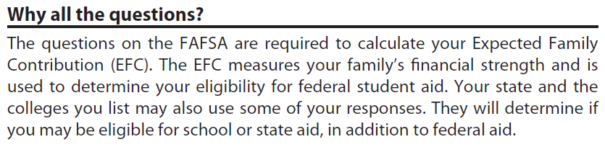
Independent other than Age
Documenting Independent Status
Financial Aid Office may require documentation of independent status:
Married – copy of marriage certificate
Support a Child – copy of child’s birth certificate and/or statement of providing more than 50% support
Legal Dependent – statement of sufficient income to provide more than 50% support
Military Active Duty or Veteran – Active Duty Orders or DD214
Parents Deceased, Ward of Court, or Foster Care – parents death certificate(s), Ward of Court letter from the state, State notice of foster care.
Emancipated Minor – Court document
Legal Guardianship – Court document

Slide 7
Independent other than Age
Homelessness
Homeless means lacking fixed, regular, and adequate housing.
Unaccompanied means you are not living in the physical custody of your parent or guardian.
Youth means you are 21 years of age or younger or you are still enrolled in high school as of the day you sign this application.
Student has been verified as an unaccompanied youth who is a homeless child or youth, by
School or school district homeless liaison.
Director, or designee, of an emergency shelter program funded by HUD.
Director, or designee, of a homeless youth basic center or transitional living program.
Financial aid administrator.
OR
Student has been verified as an unaccompanied youth who is at risk of homelessness and self-supporting by
Director, or designee, of a homeless your basic center or transitional living program.
Financial aid administrator.
Homeless (or at-risk) students who are over 21 and less than 24 years old may not be children or youths.
If no official documentation can be obtained, documented interview of the student will suffice. This is not a dependency override or PJ.

Slide 8
Example: More than 50% Support to a Dependent Child
Mary is 19 years old with a 1 year old child. She doesn’t work, lives with her boyfriend, and is approved for food stamps and WIC. Her boyfriend pays for all household expenses and gives her $100 a week in cash for the child’s needs.
Is Mary an independent student for purposes of receiving Title IV aid?
How does the food stamps, WIC, and $100 cash support effect the student’s FAFSA and aid eligibility?

Slide 9
Answer: More than 50% Support to a Dependent Child
Is Mary an independent student for purposes of receiving Title IV aid?
  Yes – the student can be considered to have a child that she provides more than half support.
How does the food stamps, WIC, and $100 cash support effect the student’s FAFSA and aid eligibility?
  Food stamps and WIC are reported as means tested benefits on the FAFSA.
  The $100 cash support received by the boyfriend is reported on the FAFSA as $5200 child support received.
Based on the 2012-2013 Student Aid Handbook (AVG-25): When the student receives money for the child from any source other than her parents, she may count it as part of her support to the child. Sources include child support and government programs, such as Temporary Assistance for Needy Families (TANF) and the Supplemental Nutrition Assistance Program (SNAP, formerly the federal Food Stamp Program), that provide benefits for dependent children. So a student may be considered independent when the benefit she receives is the primary support for her child.

Slide 10
Example: Legal Dependent
Laurel is 22 years old attending college. She is a legal guardian to her cousin Paul. Paul lives with Laurel and she receives Social Security benefits on his behalf because he is a minor. These benefits are the only source of income for Laurel and Paul.
Is Laurel considered to have a legal dependent on the FAFSA?
Does she report the Social Security benefits on the FAFSA?

Slide 11
Answer: Legal Dependent
Is Laurel considered to have a legal dependent on the FAFSA?
  Yes. Because Paul lives with Laurel and will be supported by her (through the social security benefits) throughout the year, Laurel answers “Yes” to the legal dependent question. If Paul didn’t live with Laurel, she would have to answer “No” to the question.
Does she report the Social Security benefits on the FAFSA?
  No. Social Security benefits of any kind are not reported on the FAFSA. Therefore, Laurel would report zero income and benefits on the FAFSA.
2012-2013 Student Aid Handbook (AVG-23) - When a student applies after the award year has begun, in order to
count a person not her child as a dependent, the support already given that year plus the future support must total more than 50% for the whole year. See the margin example.

Slide 12
Example: Legal Dependent
Alan is 28 years old and pays $4,000 support to his girlfriend, Cathy. Cathy, who lives with him, earned an income of $3000 and receives $200 a month ($2400) from her parents. She uses the total of $5400 for her support. Alan claims Cathy on his taxes.
Can Alan consider Cathy as a dependent on the FAFSA and include her in the family size?
How does Alan report the $4,000 he provides to Cathy on the FAFSA?

Slide 13
Answer: Legal Dependent
Can Alan consider Cathy as a dependent on the FAFSA and include her in the family size?
  No. Alan cannot consider Cathy as a dependent since the $4,000 he provides is not more than half of her total support of $9,400.
How does Alan report the $4,000 he provides to Cathy on the FAFSA?
  The $4,000 support paid is not reported anywhere on the FAFSA. However, the student may be able to request a special circumstance to exclude the $4,000 from his income if he is able to clearly document that the support was paid and why. The decision to exclude the support is at the discretion of the financial aid administrator.
2012-2013 Student Aid Handbook (AVG-23) - Legal dependents comprise children (including those who will be born before the end of the award year) of the student who receive more than half their support from the student, and other persons (except a spouse) who live with and receive more than half their support from the student as of the FAFSA signing date and will continue to do so for the award year. The same criteria apply to household size.

Slide 14
Parental Information
Who is a Parent?
“No” to all independent criteria questions (45-57) - student is dependent and must report parental information.
Parents include biological, adoptive, and stepparent (if married to biological parent).
Parent does not include foster parents, legal guardians, and relatives. Student whose (any time since the age of 13) parents are deceased, or was in foster care is considered independent for the purpose of completing the FAFSA.

Slide 15
Parents’ Personal
Information
The FAFSA asks for parents’ SSNs, last names, first initial, date of birth, and month and year they were married, separated, divorced, or widowed.
  This is to prepare for a possible match with the IRS on AGI, taxes paid, filing status, and number of exemptions claimed.
If the SSN, last name, and birth date for at least one parent are not provided, or if neither parent’s SSN matches with the Social Security Administration, the application will be rejected.
When the SSN doesn’t match with SSA, the wrong number must be corrected so that the application and SSA agree.
  For a name or birth date that doesn’t match, correct the application if it’s wrong or re-enter the information if it’s correct.
  If the parent doesn’t have an SSN, enter 000-00-0000 to prevent or remove a reject code. (See also the SSN chapter in Volume 1 of the Federal Student Aid Handbook.)

Slide 16
Parental Information
Divorce/Separation - Which Parent?
Student does not have to be living with parents to be required to report parental information.
Priority Order for Divorced or Separated Parents:
  Which parent did student live with more during the 12 months preceding FAFSA completion date.
  If live(d) with neither or both equally, which parent provided more financial support during the 12 months preceding FAFSA completion date.
  If financial support is exactly 50/50, which parent has the greater income and benefits.
A couple doesn‘t have to be legally separated in order to be considered separated for purposes of the FAFSA.
The couple may consider themselves informally separated when one of the partners has permanently left the household.
If the partners live together, they can‘t be considered informally separated.
IFAP – Completing the FAFSASM 2012-13
71 Pages of FAFSA filing instructions with FAQs, examples, and guidance.

Slide 17
Example: Who is a Parent
Christopher is 18 years old and lives with his grandmother who is a legal guardian but not an adoptive parent. The whereabouts of his biological mother and father are unknown.
His grandmother has taken care of him since he was age 2. Christopher does not work and receives all his support from his grandmother.
His grandmother gives him approximately $50 a week in cash support. The remaining support is in the form of in-kind for food, shelter, and clothing.
How does Christopher complete the FAFSA?

Slide 18
Answer: Who is a Parent
How does Christopher complete the FAFSA?
  Christopher completes the FAFSA as an independent student by selecting Yes to Question 54 – Are you or were you in legal guardianship.
  The $50 per week Christopher receives from his grandmother must be reported as other unreported income. The in-kind support is not reported.
2012-2013 Student Aid Handbook (AVG-25) - If a student is living with her grandparents or other relatives, their data should not be reported on the FAFSA as parental data unless they have adopted the student. Any cash support from persons other than the student’s parents should be reported as untaxed income, as discussed in Step 2. The school may also consider other kinds of support as part of the student’s financial resources and use professional judgment to include the support under the item for student’s untaxed income.

Slide 19
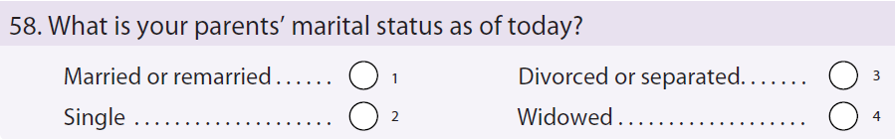
Example: Who is a Parent
Michelle is dependent and her biological parents are divorced. She lives with her mother and her mother’s new husband.
Michelle’s biological father is very involved in Michelle’s life and takes her as often as he can. Based on the divorce agreement, living arrangements, and finances, her mother is considered to provide more than half support.
Michelle’s mother was married a few weeks ago and her new stepfather was not in her life until 6 months before her mother remarried.
How does Michelle complete the FAFSA?

Slide 20
Example: Who is a Parent
How does Michelle complete the FAFSA?
  Student must complete the FAFSA as a dependent student and financial information of her mother and new stepfather.
  Any child/financial support provided to Michelle or her mother from her biological father are reported as untaxed income on the FAFSA.
2010-2011 Student Aid Handbook (AVG-29) - A stepparent is treated like a biological parent if the stepparent has legally adopted the student or if the stepparent is married, as of the date of application, to a student’s biological or adoptive parent whose information will be reported on the FAFSA. There are no exceptions. A prenuptial agreement does not exempt the stepparent from providing information required of a parent on the FAFSA. The stepparent’s income information for the entire base year, 2011, must be reported even if the parent and stepparent were not married until after 2011. See above for how to fill out the parent questions when the stepparent’s spouse (the biological parent) dies; if the stepparent has not adopted the student, he would no longer provide parental information
as before, but any financial support he gives to the student would be counted as untaxed income.

Slide 21
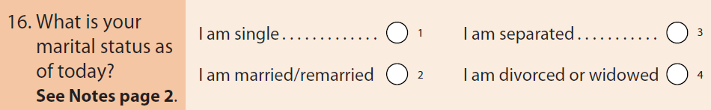
Marital Status
Marital Status is based on the day the FAFSA is filed.
Engaged - Unmarried unless he/she waits until after the wedding to complete the FAFSA.
Student is married if he/she is separated or planning to divorce or if he/she meets the criteria for common-law marriage in his/her state.
  States that recognize common-law marriage are Alabama, Colorado, Iowa, Kansas, Montana, Rhode Island, South Carolina, Texas, Utah, and Washington, D.C.
Independent only because he/she was married becomes dependent for the next award year if she divorces and cannot answer yes to any of the dependency questions.
According to the Defense of Marriage Act (1996), “…the word ‘marriage’ means only a legal union between one man and one woman as husband and wife, and the word ‘spouse’ refers only to a person of the opposite sex who is a husband or a wife.” Therefore, same-sex unions are not considered marriages for federal purposes, including the FAFSA.

Slide 22
Example: Marital Status
George’s parents divorced when he was seven. His mother later remarried and George lived with his mother and stepfather.
His stepfather didn’t adopt him. His mother died last year, but his biological father is still living.
George is living with and supported by his stepfather who earns much less than his biological father.
George doesn’t meet any of the independence criteria, so he’s a dependent student.
Whose information does George report on the FAFSA?

Slide 23
Answer: Marital Status
Whose information does George report on the FAFSA?
  Because his biological father is his only surviving parent, George needs to report his father’s information on the form, even though he’s still living with and being supported by his stepfather.
  Stepfather cannot be used on the FAFSA because his did not adopt the student.

Slide 24
Example: Which Parent?
Joe has filed his FAFSA with income for two parents and provided separate tax returns for both parents. According to marital status date on FAFSA, parents were married 3 months prior to filing FAFSA.
Verification worksheet lists himself and two parents – Mary (mother) and Jane (mother). They live in Massachusetts where it is legal for same sex marriages.
The data on both sets of taxes matches the amounts reported on the FAFSA. Family size is reported on FAFSA as 3.
Did Joe complete the FAFSA correctly?

Slide 25
Answer: Which Parent?
Did Joe complete the FAFSA correctly?
  No. Joe needs to use the biological mother’s information or, if neither are biological, determine which mother provided more than 50% support, adjust income to include only one mother’s information, and remove the other mother from the family size.
  Same sex marriages are treated as if they are divorced or separated.
  Parent data is only for the custodial parent or is the “biological” or “adoptive” parent. If both are custodial, then it is the person who provides the greatest support, usually the parent with the greatest income.
  PJ can be used to consider contributions from second mother as untaxed income.
―parent is not restricted to biological parents. There are instances (such as when a grandparent legally adopts the applicant) in which a person other than a biological parent is treated as a parent, and in these instances, the parental questions on the application must be answered, since they apply to such an individual (or individuals).

Slide 26
Example: Marital Status Conflict
Jane is dependent and submitted parents taxes as married. She and parents are residents from Minnesota.
Jane filled out the FAFSA with just her Mother’s financial information with marital status of divorced/separated. Mother was the only parent listed on the verification worksheet.
Jane’s Father and Mother both signed the verification worksheet and both parents’ name, SSN, and DOB was listed on the FAFSA.
What is the conflicting information, if any?

Slide 27
Answer: Marital Status Conflict
What is the conflicting information, if any?
  Need clarification of marital status and documentation to support. May need an updated verification worksheet.
  Parents reside in Minnesota and legal separation is recognized in Minnesota.
  Parents will need to provide an explanation of why the taxes were filed as married, how long they have been living apart (if they are), and whether they are divorced or separated.
  Documentation to support the marital status should be requested.
  FAFSA, documentation, and verification worksheet must all be consistent and any conflicting information resolved.
  No questions or concerns left unanswered.
You must resolve any inconsistent or conflicting information shown on the output document before making any adjustments. (Ch. 5 – Pg. AVG-103)

Slide 28
Example: Are they married?
Jane is a dependent student, originally from Texas, whose biological parents live together and share all income and expenses.
Jane and parents moved to Florida when Jane was age 12. Jane attends school in Massachusetts.
Parents filed taxes as married but never obtained an official marriage certificate. They introduce themselves as married.
Student reported parents as married on the FAFSA, reported both their income, but indicated on the verification worksheet that they are not legally married.
Are Jane’s parents married for the purpose of completing the FAFSA?

Slide 29
Answer: Are they married?
Are Jane’s parents married for the purpose of completing the FAFSA?
  Yes, the student completed the FAFSA correctly.
  Alabama, Colorado, Iowa, Kansas, Montana, Rhode Island, South Carolina, Texas, Utah, and Washington, D.C. are all states that recognize common law marriage.
  Texas: A man and woman who want to establish a common-law marriage must sign a form provided by the county clerk. In addition, they must (1) agree to be married, (2) cohabit, and (3) represent to others that they are married.
  Parents are afforded all the rights of a married couple and retain those rights even if they move to a different state.

Slide 30
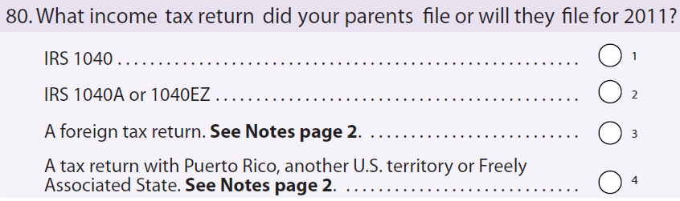
Tax Filing Status
Student Aid Handbook: Financial aid administrators do not need to be tax experts but there are some issues that even a layperson with basic tax law information can evaluate.
FAAs must have a fundamental understanding of relevant tax issues that can considerably affect the need analysis.
  You are obligated to know:
  (1) whether a person was required to file a tax return,
  (2) what the correct filing status for a person should be, and
  (3) that an individual cannot be claimed as an exemption by more than one person.
Publication 17 of the IRS, Your Federal Income Tax, is a useful resource for aid administrators. You can view it on the Web at www.irs.gov or you can call the IRS at 1-800-829-3676 to order a copy.
FAA noticing that a dependent student’s married parents have each filed as “head of household” - Must question whether or not there is an incorrect filing status.

Slide 31
Tax Filing Status
Head of Household Definition (Publication 17)
You may be able to file as head of household if you meet all of the following requirements.
  Unmarried or “considered unmarried” on the last day of the year
  Paid more than half of the cost of keeping up a home for the year
  A “qualifying person” lived in the home for more than half the year
    If “qualifying person” is your dependent parent, he/she does not have to live in home.
Considered Unmarried on the last day of the tax year , if:
  File a separate return
  Paid more than half the cost of keeping up your home for the tax year
  Spouse did not live in home during last 6 months of the tax year
  Home was the main home of child, stepchild, or foster child for more than half the year. Home of qualifying person
  Must be able to claim an exemption for the child
Publication 17 (pg. 23) – Your girlfriend lived with you all year. Even though she may be your qualifying relative, she is not your qualifying person for head of household purposes because she is not related to you under the tax definition of Relative.

Slide 32

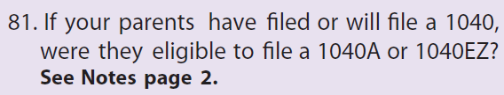
Eligible to File 1040A
Eligible to file a 1040A or 1040EZ
Taxable income is less than $100,000
Do not itemize deductions
Do not receive income from business or farm
Do not receive alimony
Not Eligible to file a 1040A or 1040EZ
Itemize deductions
Self-employed
Receive alimony
File schedule D for capital gains

Slide 33
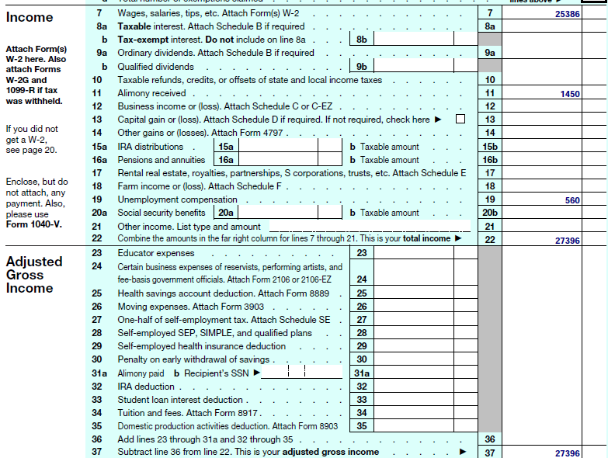
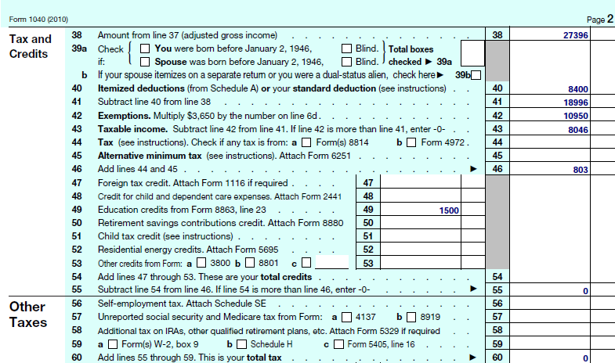
Example: Eligible for 1040A
Is this person eligible to file a 1040A?

Slide 34
Answer: Filing Status
Is this person eligible to file a 1040A?
  No, because student is claiming alimony received.
  Can use Form 1040A if all of the following apply:
    Income is only from wages, salaries, tips, IRA distributions, pensions and annuities, taxable social security benefits, taxable scholarship and fellowship grants, interest, ordinary dividends, capital gain distributions, and unemployment compensation.
    On line 13 “If not required, check here” is checked then they are eligible to file 1040A. If box not checked, then not eligible to file.
      From the IRS site: “If you have only capital gains distributions and no other capital gains, you may report the figure directly on Form 1040A line 10 or Form 1040 line 13 without filling out a Schedule D.”
    Taxable income is less than $100,000 (not AGI or wages)
    Adjustments to income are for only IRA deduction and student loan interest deduction
    Do not itemize your deductions
Some believe the only items that determine 1040A filing status is lines 12, 13, 14, 17, 18, and 40. Some don’t realize there is an income cap and line 13 depends on check box.

Slide 35
Student Data
Student reporting not required to file a 2011 income tax return
  Income is reported using W-2 forms and other tax or benefit documents
Student must file federal taxes if:
  Dependent student claimed by a parent earning more than $5800 or receiving unearned income of more than $950.
  Independent unmarried student earning more than $9,500.
  Married filing jointly earning more than$19,000.
  Students with business income of over $400.
Dependent students who are claimed by their parents cannot claim themselves on their taxes. If both claim, student must amend.
Dependent students must complete asset information as of the FAFSA filing date. Assets include cash, savings, checking, stocks, bonds, investment property, and trust funds.

Slide 36
Parental Data
Benefits from Federal Programs (means-tested), questions 74-78
  SSI, Food stamps, Free or Reduced Price Lunch, TANF, WIC
  If parents’ taxable income is less than $32,000, did not file or 1040A, and any of the means-tested benefits are selected, student qualifies for automatic 0 EFC. All other data disregarded.
Either parent is a dislocated worker, question 82
  If parents’ taxable income is less than $32,000, parents did not file or 1040A, and either parent dislocated worker, the student qualifies for an automatic 0 EFC. All other data disregarded.
“Don’t know” is treated as “No” by the CPS
  Not required to verify response but some schools question dislocated worker.
Student without a parent (professional judgment)
  Documentation of unusual circumstances should come from a third party that knows the student’s situation (teacher, counselor, medical authority, or member of the clergy).
  If third party documentation is truly not available, the school can accept a signed and dated statement from the student or a family member detailing the unusual circumstances. Such a statement should be a last resort.

Slide 37
Dislocated Worker Status
Dislocated worker is defined (see 29 U.S.C. 2801) in the Workforce Investment Act of 1998 or WIA.
  A person who meets all of the following requirements:
  he was terminated or laid off from employment or received a notice of termination or layoff;
  he is eligible for or has exhausted his unemployment compensation,
    or he is not eligible for it because, even though he has been employed long enough to demonstrate attachment to the workforce, he had insufficient earnings or performed services for an employer that weren’t covered under a state’s unemployment compensation law; and
  he is unlikely to return to a previous industry or occupation.
Student Aid Handbook (AVG- 27) – Listing of Additional Dislocated Worker Statuses:
  Includes but is not limited to (see handbook for full listing):
  A person who was terminated or laid off from employment or received a notice of termination or layoff.
  A person who is employed at a facility at which the employer made a general announcement that it will close within 180 days.
  A self-employed person (including farmers, ranchers, or fishermen) who is unemployed because of natural disasters or because of general economic conditions in his community.
AVG–30 Ch. 2—If you must determine if someone is a dislocated worker, you have sole responsibility and must make the determination regardless of whether the person has proof of dislocated worker status—or is receiving dislocated worker services—from the workforce investment system.

Slide 38
Example: Document Dislocated Worker Status?
Bethany completed her FAFSA stating that her one of her parents is a dislocated worker. She sent in a copy of her parents’ taxes (without school’s request) and there is no indication that either parent is a dislocated worker.
They both have a job, worked the full year (according to tax documents), do not receive unemployment, and were not self-employed.
Is there a conflict and if required, what documentation is acceptable to verify dislocated worker status?

Slide 39
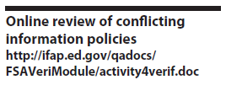
Answer: Document Dislocated Worker Status?
Is there a conflict and if required, what documentation is acceptable to verify dislocated worker status?
  Verifying dislocated worker status is not required for 2012-2013 under 34 CFR 668.56 – Required Verification Items.
  A copy of taxes is not considered conflicting information in this case – See Dislocated Worker section of the SFA Handbook.
  FAA can request documentation if there is reason to believe that any information on an application used to calculate an EFC is inaccurate (34 CFR 668.54(a)(3)).
  A person can request documentation from the career center or other appropriate office that he is receiving dislocated worker services through the workforce investment system.

Slide 40
Household Size
Household size (questions 72 and 93) includes:
  INDEPENDENT STUDENT:
    Student and his or her spouse
    Student’s children
    Other persons who live with and receive more than half their support from the student.
  DEPENDENT STUDENT:
    Student and parent(s), even if the student is not living with them.
    The student’s siblings and children, if they will receive more than half their support from the student’s parent(s) from July 1, 2011, through June 30, 2012.
    Siblings need not live in the home.
    Other persons who live with and receive more than half their support from the student’s parent(s) and will receive more than half support for the entire award year.
AVG-26: For children in the household size, the “support test” is used rather than residency because there may be situations in which a parent supports a child who does not live with her, such as when the parent is divorced or separated. If the parent receives benefits (such as Social Security payments) in the child’s name, these benefits must be counted as parental support to the child. An exception to this is foster care payments, which typically cover the costs of foster children, who for FSA purposes are not considered children of the foster parents and are not counted in the household size.

Slide 41
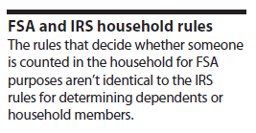
Household Size Continued…
Foster children, who for FSA purposes, are not considered children of the foster parents and are not counted in the household size.
To determine whether to include children in your household size, the support test is used (rather than a residency requirement).
The parent who provides more than half of the child‘s support may claim the child in his or her household size.
If a parent receive benefits (such as Social Security or Temporary Assistance for Needy Families [TANF] payments) in the child‘s name, these benefits must be counted as parental support to the child.
Support includes money, gifts, loans, housing, food, clothes, car payments or expenses, medical and dental care, and payment of college costs.
The number of family members reported determines the allowance that will be subtracted from the family‘s income to provide for basic living expenses when the Department‘s processor calculates the Expected Family Contribution (EFC).

Slide 42

Number in College
Number in College always includes the student, but parents are not included.
  Others who count in the household size are in the number in college if they are or will be enrolled at least half time, in an eligible program, at a school eligible for FSA funds.
  The definition of half-time enrollment for this question must meet the federal requirements even if the school defines half time differently.
  Do not include students at a U.S. service academy because most of their primary educational expenses are paid for by the federal government.
    Military service academies and preparatory schools: U.S. Military Academy (West Point); U.S. Naval Academy (Annapolis); U.S. Air Force Academy; U.S. Coast Guard Academy; U.S. Merchant Marine Academy; U.S. Military Academy Preparatory School; Naval Academy Preparatory School; U.S. Air Force Academy Preparatory School .

Slide 43
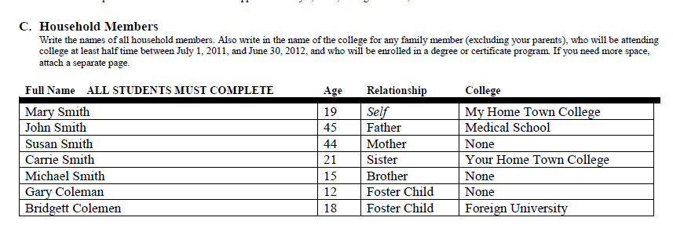
Example: Household Size & Number in College
What is the correct number in household and number in college?

Slide 44
Answer: Household Size & Number in College
What is the correct number in household and number in college?
5 in household size, 2 in college.
    Foster children, who for FSA purposes are not counted in the household.
    The applicant is always included in the number in college, but parents are not included.
    Others who count in the household size are in the number in college if they are or will be enrolled at least half time in an eligible program at a school eligible for any of the FSA programs.
Common mistakes – Including foster children in household size. Including parents in number in college.
Household size documentation and exceptions
Student assistance general provisions
34 CFR 668.57(b)
34 CFR 668.56(a)(3), (b), (c)

Slide 45


Tax Expert
Student Aid Handbook (AVG-103) - We have already stated that financial aid administrators do not need to be tax experts, yet there are some issues that even a layperson with basic tax law information can evaluate. Because conflicting data often involve such information, FAAs must have a fundamental understanding of relevant tax issues that can considerably affect the need analysis.
You are obligated to know:
  whether a person was required to file a tax return,
  what the correct filing status for a person should be, and
  that an individual cannot be claimed as an exemption by more than one person.
AVG-104: For example, an FAA noticing that a dependent student’s married parents have each filed as “head of household” (which offers a greater tax deduction than filing as single or married) must question whether that is the correct filing status. Publication 17 explains on pages 21–23 the criteria a person must meet to file as head of household. Resolution of the conflict may be a reasonable explanation of why there appears to be a conflict but is none, or the parents may re-file and submit a copy of the amended return.

Slide 46

IRS Publication 17
Online Location
  http://www.irs.gov/publications/p17/index.html
Information
  Required to file
  Criteria for filing 1040, 1040A, 1040EZ
  Filing Status
    Married filing joint, Married filing separate, Head of household
  Marital Status
  Exemptions
  Description of forms and schedules
  Tax Tables
  What’s new
    http://www.irs.gov/publications/p17/ar01.html
Making work pay credit. The making work pay credit has expired. You cannot claim it on your 2011 return. Schedule M is no longer in use.

Slide 47
Tax Marital Status
Marital Status for Tax Filing is determined on December 31st
  Married living with spouse – only 2 choices for filing taxes
    Married filing joint or Married filing separately
  Not legally married
    Single
  Head of household (highest deductions) – criteria is:
    Must be single or considered single for tax purposes.
    File a separate tax return.
    Spouse did not live in your home during the last 6 months of the tax year, including temporary absences (see publication 17 for details).
    Must maintain more than half the cost of a household and residing in the household.
    Have one or more qualified dependent and be able to claim that person as an exemption.
If filing status is determined to be incorrect, parent or student must file a 1040X amended return. Tax Account Transcript is the result of filing the 1040X.

Slide 48
Tax Marital Status Definitions
Single (unmarried) - Considered unmarried for the whole year if, on the last day of your tax year, unmarried or legally separated from spouse under a divorce or separate maintenance decree.
  State law governs whether married or legally separated under a divorce or separate maintenance decree.
    All states except Delaware, Florida, Georgia, Mississippi, Pennsylvania, and Texas recognize legal documentation of separation.
  Divorced under a final decree by the last day of the year, considered unmarried for the whole year.
Married - Considered married for the whole year if on the last day of tax year filer and spouse meet any one of the following tests.
  Married and living together as husband and wife.
  Living together in a common law marriage (CLM) that is recognized in the state where you now live or in the state where the CLM began.
    CLM is recognized in Alabama, Colorado, Iowa, Kansas, Montana, Rhode Island, South Carolina, Texas, Utah, and Washington, D.C.
  Married and living apart, but not legally separated under divorce decree or separate maintenance.
  You are separated under an interlocutory (not final) decree of divorce.
    For purposes of filing a joint return, you are not considered divorced.
  If spouse died during the year, considered married for the whole year for filing status purposes.
Married persons living apart – If live apart from spouse and meet certain tests, may be considered unmarried. Can file as head of household even if not divorced or legally separated.
Nonresident alien spouse. You are considered unmarried for head of household purposes if your spouse was a nonresident alien at any time during the year and you do not choose to treat your nonresident spouse as a resident alien. However, your spouse is not a qualifying person for head of household purposes. You must have another qualifying person and meet the other tests to be eligible to file as a head of household.

Slide 49

Example: Qualifying Dependent
George submitted his taxes using head of household as his tax filing status. He claimed his girlfriend as a qualifying dependent.
His girlfriend has been living with him since 2009, he pays all the expenses to run the household, and he supported his girlfriend 100% for the entire year (she doesn’t work or receive any benefits).
Is George eligible to file as head of household?

Slide 50
Answer: Qualifying Dependent
Is George eligible to file as head of household?
  No, he cannot file as head of household because his girlfriend does not meet the conditions of qualifying person.
    He met all of the head of household conditions except the question of “Who is a Qualifying Person Qualifying you to file as head of household?”
    Qualifying person is either a qualifying child (son, daughter, or grandchild), qualifying relative (father or mother), or qualifying relative other than father or mother (must meet certain tests).
    Qualifying relative is:
      Your child, stepchild, foster child, or a descendant of any of them (for example, your grandchild). (A legally adopted child is considered your child.)
      Your brother, sister, half brother, half sister, stepbrother, or stepsister. A son or daughter of your brother or sister. A son or daughter of your half brother or half sister.
      Your father, mother, grandparent, or other direct ancestor, but not foster parent.
      Your stepfather or stepmother.
      A brother or sister of your father or mother.
      Your son-in-law, daughter-in-law, father-in-law, mother-in-law, brother-in-law, or sister-in-law.
If at any time during the year the person was your spouse, that person cannot be a qualifying relative.

Slide 51
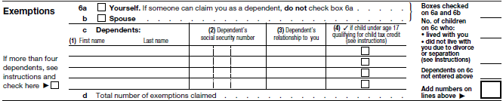
Exemptions
Two Types:
  Personal exemptions for yourself and your spouse, and
  Exemptions for dependents (dependency exemptions).
Spouse is never considered a dependent
Allowed one exemption for each person filer can claim as a dependent. Can claim an exemption for a dependent even if dependent files a return. The term “dependent” means:
  A qualifying child or a qualifying relative.
Cannot claim any dependents if filer, or spouse if filing jointly, could be claimed as a dependent by another taxpayer.
Dependent not allowed a personal exemption. If filer claims as an exemption, the dependent cannot claim his/her own personal exemption on his/her own tax return. This is true even if filer did not claim the dependent's exemption on return.

Slide 52
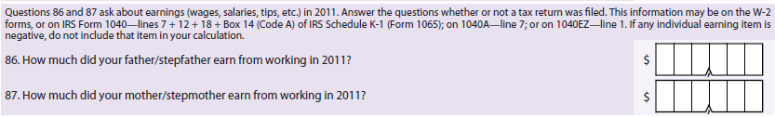
Wages–Income Earned from Work
Non-Tax Filers – Verify wages with documentation
Wage Statements
  Form W-2
  Form W-2G – Gambling Winnings
  1099 Series
Location of Wage Figures
  W-2 (line 1 or 5)
  Form 1040–Lines 7+12+18 (negative figure on line 12 is treated as 0)
  Form 1040A-Line 7 and 1040EZ-Line 1
  IRS Schedule K-1(form 1065)-Box 14 (Code A)

Slide 53
  Education Credits &
  Taxable Grant and Scholarships
Education Credits (tax deduction, not tax credit):
  American Opportunity Tax Credit
  Hope or Lifetime Learning Tax Credit
  Form 1040-Line 49
  Form 1040A-Line 31
Taxable Grant and Scholarship:
  Qualified scholarship and fellowship grants are treated as tax-free amounts if the following conditions are met:
    Candidate for a degree at an educational institution that maintains a regular faculty and curriculum and normally has a regularly enrolled body of students in attendance at the place where it carries on its educational activities; and
    Amounts receive as a scholarship or fellowship grant are used for tuition and fees required for enrollment or attendance at the educational institution, or for fees, books, supplies, and equipment required for courses at the educational institution.
  Scholarships or Grants: You must include in gross income amounts used for incidental expenses, such as room and board, travel, and optional equipment, and generally amounts received as payments for teaching, research, or other services required as a condition for receiving the scholarship or fellowship grant. Also you must include in income any part of the scholarship or fellowship that represents payments for services.

Slide 54
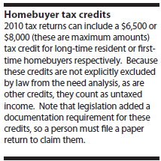
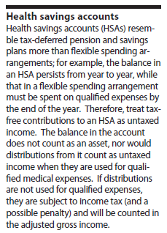
  Tax Exempt Interest,
  First-time Homebuyer Credit, HSAs
Tax-exempt interest income
  Certain types of interest, such as interest on municipal bonds, are tax-exempt.
  Line 8b on both the 1040 and 1040A.
First-time Homebuyer Credit.
  1040 – Line 67.
  Publication 17 -
    To claim the first-time homebuyer credit for 2011, must have been a member of the uniformed services or Foreign Service or an employee of the intelligence community on qualified official extended duty outside the United States for at least 90 days during the period beginning after December 31, 2008, and ending before May 1, 2010.
  Reported as “Any other untaxed income not reported elsewhere.”
Health Savings Accounts (AVG-19)
  1040 – Line 25. Some thought that they should be excluded from the need analysis just as flexible spending arrangements are, but because HSAs are like tax deferred pension and savings plans, they should be treated similarly.
  Reported as “Any other untaxed income not reported elsewhere.”

Slide 55
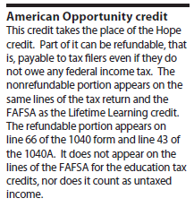
Untaxed Income and Credits NOT Reported
Untaxed Social Security Benefits – all untaxed social security benefits are excluded on the FAFSA, including those that appear on the tax form
  1040–Line 20a minus 20b or 1040A-Line 14a minus 14b
Credit for child and dependent care expenses
Child tax credit
Residential energy credits
Earned income credit
Additional child tax credit
American opportunity credit
Credit for federal tax on fuels
SFA Handbook (AVG-88) – You must verify all other untaxed income reported on the U.S. Individual income tax return (excluding schedules).

Slide 56
Using Tax Schedules
Schedule C or C-EZ – Business Income
  Wages/Earnings or Business Assets
Schedule B – Taxable interest
  Cash, Savings, or Checking Assets
Schedule D – Capital gain or (loss)
  Investment Assets
Schedule F – Farm income or (loss)
  Farm Assets
Schedule E – Rental real estate, royalties, partnership, S corporations, trusts, etc.
  Real Estate Investment assets or Business Assets
  Non-passive income (j) from schedule K-1 – report positive amount as income earned from work
The financial aid office is not required to request and collect specific tax schedules. However, if received, must be reviewed and conflicting information resolved.

Slide 57
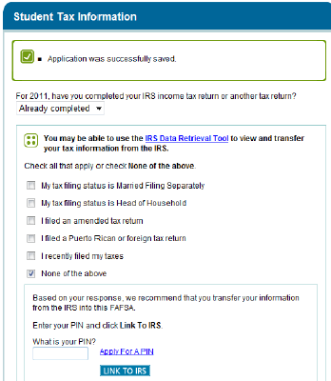
IRS Data Retrieval Tool (DRT)
Students and Parent can use the IRS Data Retrieval Tool beginning February 6, 2012.
Tax data can be retrieved:
  2 weeks after filing electronically
  8 Weeks after filing by paper
IRS DRT Online Logic
  Filing timeframe
  Completion - “Already completed”
  Marital Status
  Filing Status (eg. HOH)
  Dynamic Filtering Questions
  Eligible or Ineligible Message
2012-2013 FAFSA Instructions:
The easiest way to complete your FAFSA with accurate tax information is by using the IRS Data Retrieval Tool through www.fafsa.gov.

Slide 58
Unable to use IRS Data Retrieval Tool
Dynamic Filtering/Logic – Ineligible to use if:
  Has not file taxes
  Filed by paper in past 8 weeks
  Filed electronically in past 2 weeks
  Tax filing status is Married Filing Separately
  Tax filing status is Head of Household
  Filed an amended tax return
  Filed a Puerto Rican or foreign tax return
Instructions encourage those who could not use because they haven’t filed or recently filed to go back and retrieve tax data using the online corrections process.
Reminder emails will be sent by CPS with reminders to go back in and use IRS DRT.
Ineligible applicants will receive the message, “Based on your response, you are not eligible to transfer your information from the IRS into this FAFSA.”

Slide 59
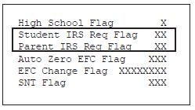
Challenges to the IRS DRT
Applicant/parent(s) have changed their martial status or now married to another person
There has been a death of one parent
Filed a Tax filing extension
Cannot obtain a Transcript (PR or foreign tax forms filed)
IRA Rollovers are an issue
Applicant or Parent(s) do not or cannot use the DRT
Taxable Grant/Scholarship Aid

Slide 60
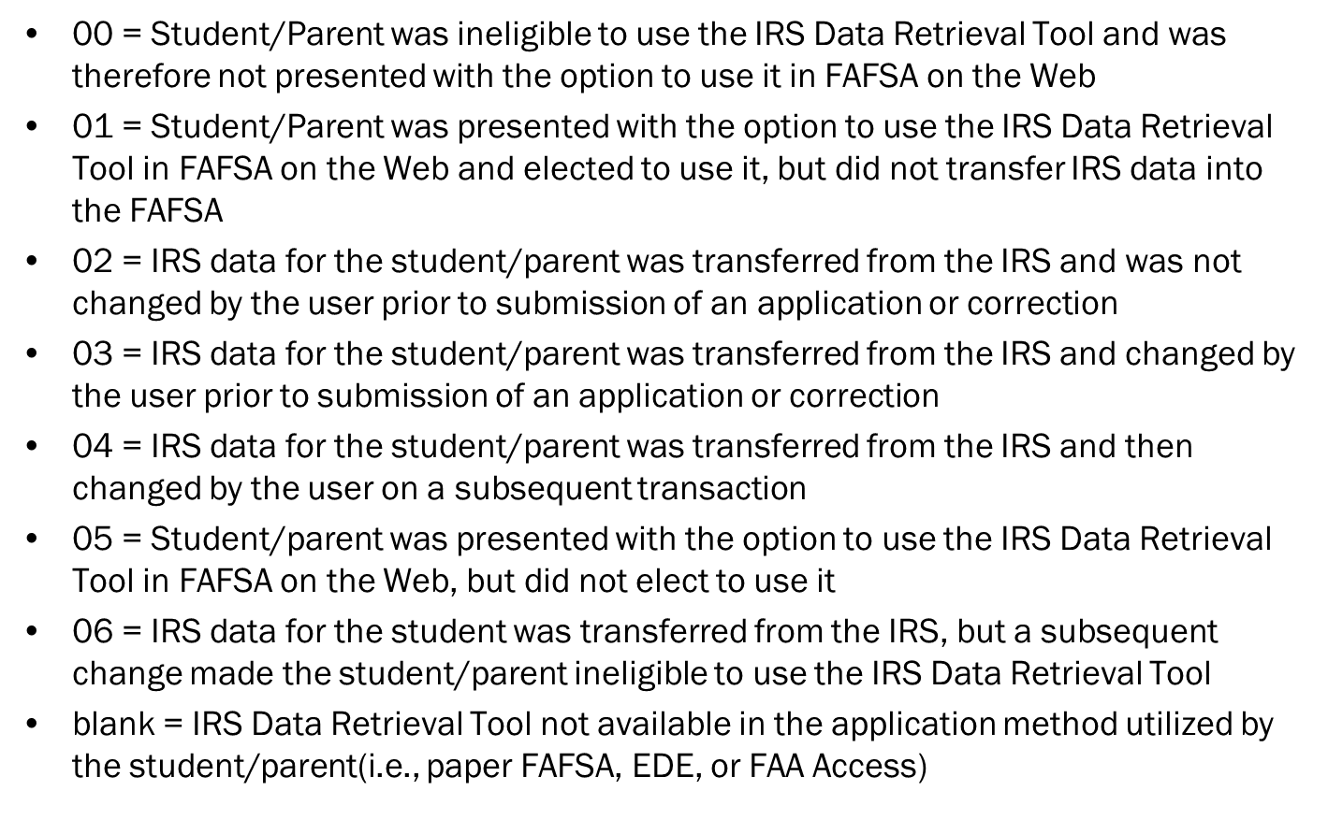
IRS DRT – Data Flags
02 Data Flag – School can waive the requirement of collecting a copy of tax transcript, if selected. However, school can still choose to require student to submit a copy of tax transcript for verification.

Slide 61
IRS Tax Transcript
Dear Colleague Letter GEN-11-03:
  Since most applicants can quickly and easily access IRS data through the FAFSA-IRS Data Retrieval process, we no longer consider it reasonable for an institution to accept anything less reliable than direct IRS-supplied evidence for verification of income data. Therefore, if an applicant selected for verification has not successfully transferred information from the IRS, or one who did transfer the information but then changed it, the Department expects the institution to require the applicant, and if necessary the applicant's parents, to provide an official IRS transcript of their Federal income tax information.
Acceptable Documentation
  34 CFR 668.57(a) and (d).
    FR, Vol. 76, No. 134, pages 41231-41233.
    Dear Colleague Letter GEN-11-03.
    Dear Colleague Letter GEN-11-13.
  Priority Order for Acceptable Documentation (Federal Register 7/13/11):
    First priority: Unaltered IRS data retrieved by tax filers using FOTW (02 code).
    Second priority: IRS tax transcript for 2011, if IRS data was not retrieved or if it was retrieved and then changed.
    Third priority: Signed copy of tax filer’s 2011 federal income tax return, but only if the school determines that obtaining an IRS tax transcript is not possible (documentation).

Slide 62
Requesting a Tax Transcript
Methods of Requesting:
  Online using www.irs.gov – Results in paper transcript mailed 5-10 days
  Telephone 1-800-908-9946 - Results in paper transcript mailed 5-10 days
  IRS Form 4506-T obtained at www.Irs.gove/pub/Irs-pdf/f4506tez.pdf - Results in paper transcript mailed 5-10 days
    Option for allowing the transcript to be sent to a Third Party
The IRS provides three types of transcripts free of charge:
  Tax Return Transcript: Provides original answers for most line items on the tax return.
  Tax Account Transcript: Provides some of the information found on a tax return transcript, along with any adjustments made by the tax filer or the IRS after the original return was filed. Used for amended taxes.
  Record of Account Transcript: Insufficient for verification purposes.
Signature Requirement on the Tax Transcript –
  GEN-11-13 stated that collecting signatures on IRS tax transcripts for verification purposes is encouraged, but not required.

Slide 63
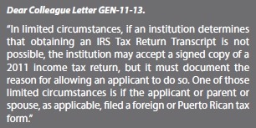
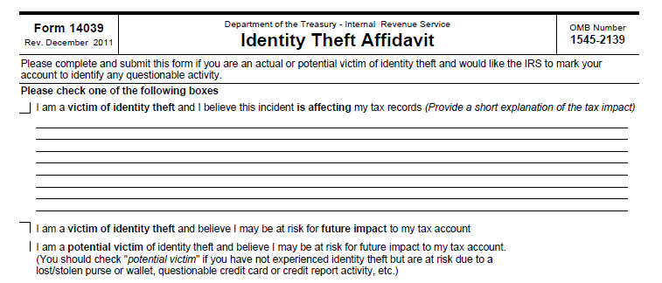
Working with the Tax Transcript
Tax Transcript Requirements
  Identity Theft
  Schools may, until July 15, 2012, use a signed copy of a 2011 IRS Tax Return as acceptable verification documentation for the 2012-13 award year, the Department of Education (ED) announced today in Dear Colleague Letter GEN-12-07.
Line items reference on the FAFSA and Tax Forms 1040/A/EZ do not appear on the IRS Tax Transcript.
Line items on IRS Tax Transcript are identified by name.
For verification purposes, it is important to identify the correct line items for comparing the answers on the FAFSA.

Slide 64
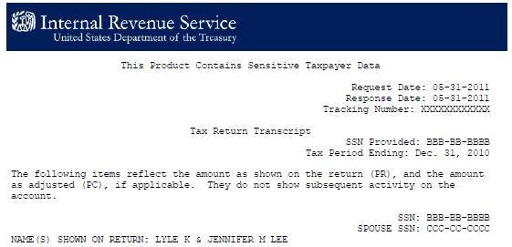
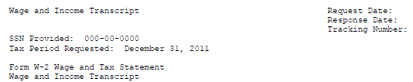


Working with the Tax Transcript

Slide 65
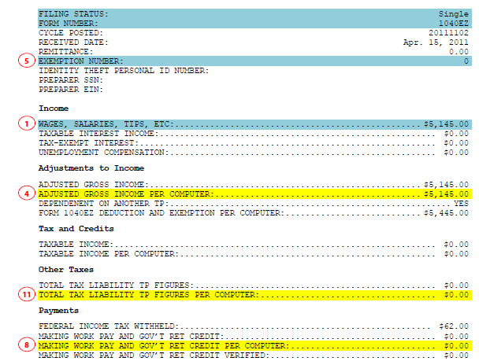
Working with the Tax Transcript
1040EZ
USA Fund University – Verification – January 31, 2012

Slide 66
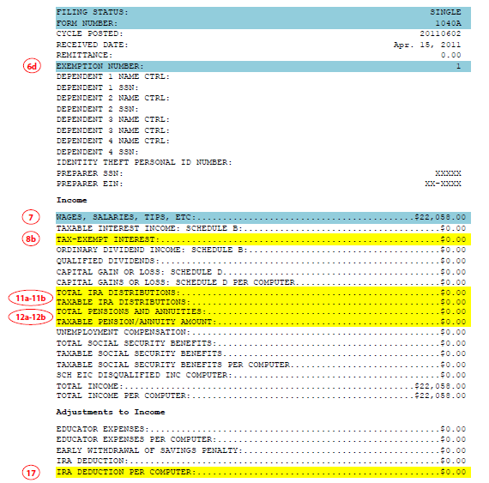
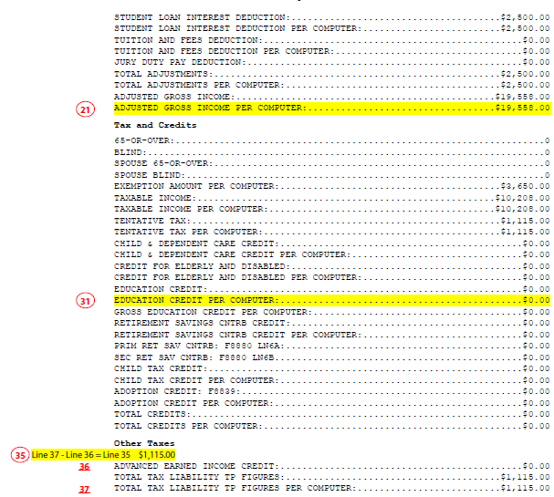
Working with the Tax Transcript
1040A

Slide 67
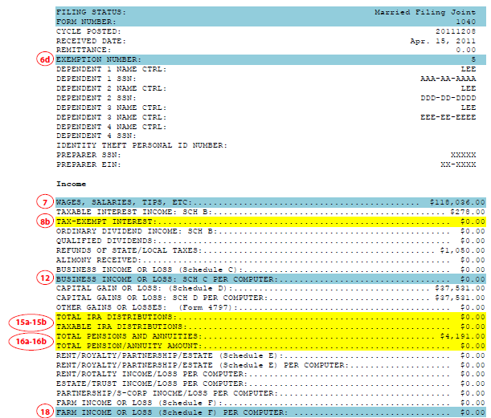
Working with the Tax Transcript
1040

Slide 68
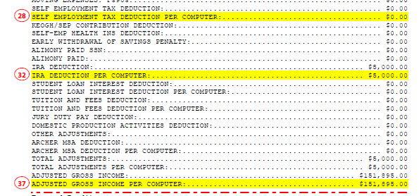

Working with the Tax Transcript
1040

Slide 69
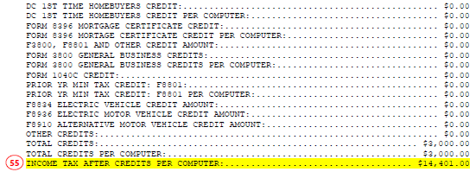
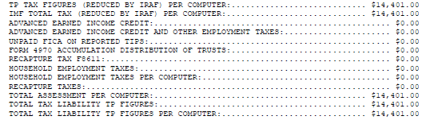
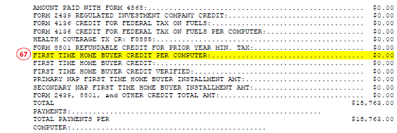
Working with the Tax Transcript
1040

Slide 70
Verification Requirements
All Applicants Selected
  Household Size
  Number in college
  Child Support Paid (if reported)
  SNAP – Food Stamps
Tax Filers
  Adjusted Gross Income (AGI)
  Federal Income Taxes Paid
  Untaxed IRA Distributions
  Untaxed Pensions
  IRA Deductions
  Education Credits
  Tax Exempt Interest Income
Non-Tax Filers
  Income Earned From Work
Sample verification worksheets
  The worksheets included in this chapter are provided by the Department as samples; you are permitted, but not required, to use them. You may modify them, design your own worksheets, or use someone else’s. Also, you may require other documentation in addition to or instead of a completed worksheet.
  Do not, however, affix the seal of the Department of Education to any verification documents.
Verification before PJ
  If you use PJ for a student who was selected for verification (by you or the Department), you must complete verification before exercising professional judgment. However, using PJ does not require you to verify a student’s application if he was not selected for verification. If you make a PJ adjustment, you must set the FAA Adjustment flag in FAA Access.
Acceptable documentation
  34 CFR 668.57
  For application information that is selected for verification in the future, the required documentation will be given in the Federal Register. See DCL GEN-11-13 for guidance about verifiable information for 2012–2013.
Verification regulations
  34 CFR 668.51–61

Slide 71
Applicants Selected for Verification
Selection Process (34 CFR 668.54) -
  FAFSA selected by Central Processing System (CPS) or the School
    School selection criteria must be applied fairly and consistently to all applicants.
  CPS Select Applicants – Random or by a series of federal edits
Verification Exclusions (34 CFR 668.54(b)):
  Student dies during award year
  Student is not a Title IV recipient
  Student or parent eligible for unsubsidized aid only
  Applicant is verified by another school (need statement from school that applicant was verified and transaction is valid ISIR)
  See handbook for parent and spouse exclusions
2012-2013 FSA Handbook, p. AVG-76.
  "You must verify any information you have reason to believe is incorrect on any application. Students with these applications are considered to be selected for verification by your school even though you may not be verifying the same data as for CPS-selected applications. You may at your discretion require a student to verify any FAFSA information and to provide any reasonable documentation in accordance with consistently applied school policies.”
34 CFR 668.54(a)(2) – If an institution has reason to believe that an applicant’s FAFSA information is inaccurate, it must verify the accuracy of that information.

Slide 72

2012-2013 CHANGES
  Requires the processing of all changes and corrections to an applicant’s FAFSA information
  Eliminates $400 tolerance; replaces with $25 tolerance for any item
  Must report all changes, not just those that impact Pell Grants
  Eliminates the 30% institutional verification cap
  Allows the Secretary to include any item from the FAFSA for possible verification
  Replaces the five verification items for all selected applicants with a targeted selection of items based upon each student’s characteristics
QA schools are not exempt from resolving conflicting information.

Slide 73
Household Size and
Number in College
Household Size –
  Signed statement from applicant listing the name and age of each household member and the relationship to the applicant. (Verification Worksheet used by most schools). Not required when:
    Dependent student lists 2 and parent is single, divorced, separated or widowed.
    Dependent student lists 3 and parents are married.
    Independent student lists 1 and student is single, divorced, separated or widowed.
    Independent student lists 2 and student is married.
Number in College –
  Signed statement from an applicant listing the name and age of each household member attending an eligible school* at least half time for the award year, and the name(s) of the applicable school(s).
    If the school believes information from the FAFSA or signed statement is inaccurate, it must obtain confirmation of enrollment from the school.
    Must be attending a school that is eligible to participate in Title IV programs.
    Not required when number in college is 1.

Slide 74
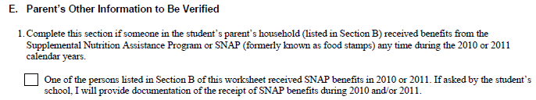
Child Support Paid and
Food Stamps (SNAP)
Child Support Paid - Statement signed by the individual.
  Who paid support, listing the amount paid, the child support recipient, and the name of the child (children) for whom support was paid.
  If the school believes information to be inaccurate, it must obtain documentation.
  Verification Worksheet - Checking the Child Support Paid box in Section D or E and signing the worksheet in Section E or F suffices as acceptable documentation for child support paid.
Supplemental Nutrition Assistance Program (SNAP)/Food Stamps - Statement signed by the individual.
  Documentation is a signed statement by the student or parent, as appropriate, affirming the response provided on the FAFSA that someone in the household did receive SNAP benefits in 2010 or 2011.
  Checking the SNAP box in Section D or E and signing the worksheet in Section E or F suffices as acceptable documentation for SNAP benefits (food stamps) unless the school requires additional documentation.

Slide 75
Adjusted Gross Income (AGI) and Taxes Paid
AGI Verification
  Used IRS Data Retrieval – Data Flag 02
  Tax Transcript – Adjusted Gross Income Per Computer
  Unable to Obtain Tax Transcript (must be documented)
    1040 – Line 37, 1040A – Line 21, 1040EZ – Line 4
Taxed Paid Verification
  Used IRS Data Retrieval – Data Flag 02
  Tax Transcript
    1040 – Income Tax After Credits Per Computer
    1040A/EZ – Total Tax Liability TP Figures Per Computer
  Unable to Obtain Tax Transcript (must be documented)
    1040 – Line 55, 1040A – Line 35, 1040EZ – Line 11

Slide 76

  Untaxed IRA Distributions
  Untaxed Pensions
Untaxed Portions of IRA Distributions
  Used IRS Data Retrieval – Data Flag 02
  Tax Transcript –
    Total IRA Distributions minus Taxable IRA Distributions
  Unable to Obtain Tax Transcript (must be documented)
    1040 – Line 15a minus 15b
    1040A – Line 11a minus 11b
Untaxed Portions of Pensions
  Used IRS Data Retrieval – Data Flag 02
  Tax Transcript –
    Total Pension and Annuities minus Total Pension/Annuity Amount
  Unable to Obtain Tax Transcript (must be documented)
    1040 – Line 16a minus 16b
    1040A – Line 12a minus 12b

Slide 77

  IRA Deductions and Payments to Self-Employed SEP, SIMPLE, Keogh, & Other Plans
IRA Deductions
  Used IRS Data Retrieval – Data Flag 02
  Tax Transcript –
    1040 – KEOGH/SEP Contribution Deductions plus IRA Deduction Per Computer
    1040A – IRA Deduction Per Computer
  Unable to Obtain Tax Transcript (must be documented)
    1040 – Line 28 plus 32
    1040A – Line 17

Slide 78
Optional Verification Items
Income Earned from Work (tax filers)
  W2 and 1099 Forms
  Schedule C
  Schedule K-1
  1040-Line 7+12+18, 1040A-Line 7, 1040EZ-Line 1
Child Support Received
  Signed Statement or Verification Worksheet
  Copy of a separation agreement/divorce decree, a statement from child support payer, or copies of cancelled checks.
Other Untaxed Income
  Housing, food and other living allowances
  Worker’s Compensation or Disability
  Unreported Income
  Other Miscellaneous sources – excluding those listed on the FAFSA instructions
Taxable Earnings from Need-based Employment Earnings
  W2 form
  Statement from college or university
  Signed Statement
Taxable Student Grant and Scholarship Aid
  Tax form
  W2 or 1042-S
  Signed Statement
Combat Pay or Special Combat Pay
  W2
  Signed Statement
Earnings from work under a cooperative education program
  Statement from college or signed from statement from the student

Slide 79

Assets
Not a required verifiable item but may be questioned.
Applicant is not required to report assets on FAFSA if:
  Independent student’s taxable income is $32,000 or less and
    Student (and the student’s spouse, if any) is eligible to file a 2011 IRS Form 1040A or 1040EZ or they are not required to file any income tax return or
    Anyone in the student’s household size (as defined on the FAFSA) received benefits during 2010 or 2011 from any of the designated means-tested Federal programs or
    Student (or the student’s spouse, if any) is a dislocated worker
  Dependent student - parents’ taxable income is $32,000 or less and
    Parents are eligible to file a 2010 IRS Form 1040A or 1040EZ or they are not required to file any income tax return or
    Anyone in the parents’ household size received benefits during 2010 or 2011 from any of the designated means-tested Federal programs or
    Either parent is a dislocated worker

Slide 80

Common Verification Errors
Income Earned from Work – Subtracting a negative business loss on line 12 of 1040 from Line 7.
  Earning information may be on the W-2 forms, or on IRS Form 1040—lines 7 + 12 + 18 + Box 14 (Code A) of IRS Schedule K-1 (Form 1065); on 1040A—line 7; or on 1040EZ—line 1. If any individual earning item is negative, do not include that item in your calculation.
Tax Paid figure from the incorrect tax line.
  Using line 37 of 1040A instead of line 35 or Using line 60 of 140 instead of line 55
  Using Total Tax Liability TP Figures Per Computer on the 1040 Tax Transcript instead of Income Tax After Credits Per Computer
Using all amounts on line 12 (a-d) to report tax-deferred pension instead of just codes D, E, F, G, H, and S.
Untaxed social security benefits are no longer reported on FAFSA.
IRA distribution is not appearing as a rollover, therefore must be reported.
Selecting “Eligible to File 1040A” as Yes when there is an amount on lines 10 or 13 of 1040
  Refunds of State/Local Taxes or Capital Gains or Loss on Tax Transcript
Including foster children in household size or parents in number in college.
Not questioning Head of Household tax filing status for a married couple.

Slide 81
Identifying Conflicting Information
All documents collected must be reviewed for conflicting information.
  Current year and prior year data.
A common area conflicting information arises is through the school’s review of an applicant’s tax returns.
ED refers financial aid administrators to specific pages in IRS Publication 17 as a resource for understanding basic tax law and detecting when conflicting tax information affects Title IV eligibility.
Financial aid administrators are required to know:
  Whether a person was required to file a tax return.
  What the correct filing status for a person should be.
  An individual cannot be claimed as an exemption by more than one person.
Conflict – Will it have an affect on EFC calculation?
34 CFR 668.16(f).
34 CFR 668.54(a)(3).
34 CFR 668.61.
2012-2013 Federal Student Aid Handbook, p. AVG-78.

Slide 82
Common Areas of Conflicting Information
Household size – Parent(s) listed conflicts with FAFSA reported data or Tax Form(s) submitted.
Marital Status conflicts with taxes or other documentation provided.
Head of Household status conflicts with marital status reported on FAFSA or verification worksheet.
Information reported in the FAFSA but not listed on a verification worksheet.
Untaxed income conflicts with information on the tax form. Example: An amount appears on line 50 of 1040 but no tax-deferred pension amount reported as untaxed income.
Both Parent and Student claim the student on their taxes.
Student or parent selected “did not file”
  Wages requiring taxes to be filed.
Greatest conflict – Marital Status discrepancies

Slide 83
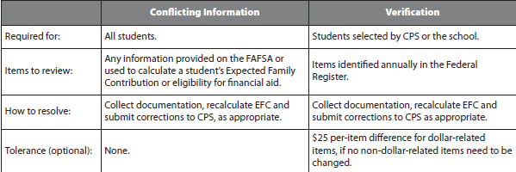
Resolving Conflicting Information
Marital Status
  Marriage Certificate, Divorce Decree, or Statement of Separation
Filing Status or Exemptions
  Statement of Confirmation
  Amended Taxes
Untaxed Income
  Written Statement, Wage Forms, or Tax Schedules
Number in College
  Enrollment Confirmation
  Written Statement
Household Size
  Written Statement
USA Fund University – Verification – January 31, 2012

Slide 84
Correcting Data
Verification Tolerance Option
  ED allows schools the option to exercise tolerance for any verification changes that do not significantly affect student aid eligibility.
  Tolerance limit is $25 for each dollar-related item. If any item goes above $25, all items must be corrected.
  Tolerance option may not be used for non-dollar-related items.
Beginning with the 2012-2013 award year, regulations require all corrections to be submitted for applicants receiving subsidized, or need-based, Title IV aid.
Federal Register, Vol. 75, No. 209, p. 66906.
Regulations allow schools to update the applicants’ marital status if the change reflects a more accurate picture of their ability to pay or to address an inequity. This can be done even if the applicant’s dependency status changes or the applicant is NOT selected for verification. A school may choose to establish a cut-off date after which no further updates to marital status will be made.
“In such cases where an FAA chooses to update a student's dependency status as a result of a change in the student‘s marital status regardless of whether the student is being verified, all of the information must be consistent with the change to the marital status. This includes income (either adding the spouse's income or deducting a former spouse‘s income) as well as household size and number in college.”
2012-2013 Federal Student Aid Handbook, p. AVG-85.
A student’s application might be selected for verification after corrections are submitted and the student has been paid based on the previous unselected CPS transaction. You must verify his application before making further disbursements. If verification does not justify aid already disbursed, then the student is responsible for repaying all aid for which he is not eligible, though he may keep any Stafford loan money he received and FWS wages he earned.

Slide 85
Example: Separated but Filed Joint Return
Eddy’s application is selected for verification. He and his wife filed a joint return for 2011 and have since separated. Both work.
The AGI on Eddy’s FAFSA matches the AGI of $58,000 and Tax Paid of $5004 on the 2011 tax return, which means it’s wrong because it includes his wife’s income. They have no qualifying dependents.
Eddy’s W-2 shows that his income for 2011 was $24,900, and the tax return shows $800 in interest income.
Student informs you that the interest is from a joint savings account. The standard deduction of $11,600 was used to calculate taxes paid.
What is the Eddy’s new AGI and Tax Paid?

Slide 86
Answer: Separated but Filed Joint Return
What is the Eddy’s new AGI and Tax Paid?
  Eddy’s AGI is $24,900 plus $400 (half of $800) = $25,300.
  Eddy’s Tax Paid is $1,949 calculated using the preferred tax table method:
    25,300 - $5,800 - $3,700 = $15,800 (taxable Income)
    $15,800 using the married filing separately on the tax table is $1,949
    FAA could have used the proportional distribution method of $25,300 divided by $58,000 = .436 times $5004 = $2,181

Slide 87
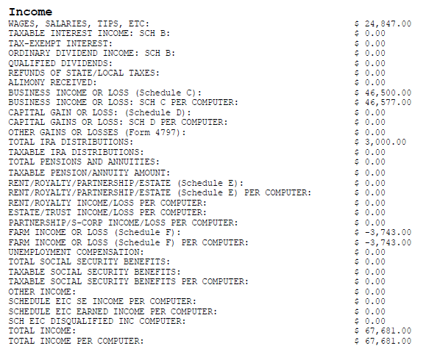
Example: Verify line items
FAFSA Data Reported:
Form Filed
1040
Eligible to file 1040A
Yes
Income Earned from Work
$71,347
IRA Distributions
$0
Is the FAFSA data correct?

Slide 88
Answer: Verify line items
Is the FAFSA data correct?
  No – see correct answers below
FAFSA Data Reported:
Form Filed
1040 - Correct
Eligible to file 1040A
Yes – Incorrect.
Answer is No because of Business Income and Farm Income
Income Earned from Work
$71,347 – Incorrect. Answer is $$71,424
(24,847 plus 46,577)
IRA Distributions
$0 – Incorrect. Answer is $3000 – Total IRA Distributions minus Taxable IRA Distributions

Slide 89
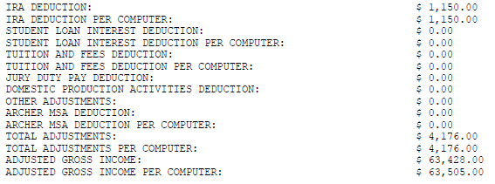
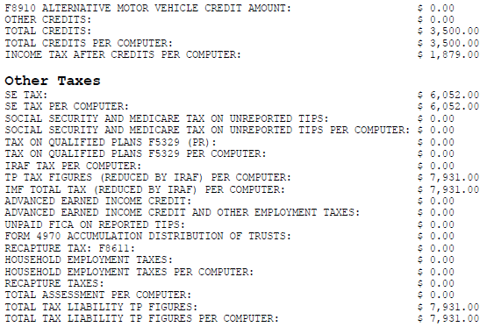
Example: Verify line items
FAFSA Data Reported:
Adjusted Gross Income
$63,428
IRA Deductions
$1,150
Education Credit
$1,000
Tax Paid
$7,931
Is the FAFSA data correct?

Slide 90
Answer: Verify Line Items
Is the FAFSA data correct?
Adjusted Gross Income
$63,428 – Incorrect. Answer is $63,505
IRA Deductions
$1,150 - Correct
Education Credit
$1,000 – Incorrect. Answer is $1,500
Tax Paid
$7,931 – Incorrect. Answer is $ 1,879

Slide 91
Verification Policies and Procedures
Required-Written Verification Policies and Procedures
  Documents needed to satisfy verification requirements
    Use of IRS Data Retrieval process, federal income tax transcripts, verification worksheet, signed statements, W2 forms.
  Deadlines for submission of documentation.
  Consequences for failing to meeting deadlines.
  Method and timeframe for notifying students of award changes resulting from verification.
  Required correction procedures for students.
  Procedures for referring students to the Office of Inspector General (OIG).
AVG-76 - Policies and Procedures
34 CFR 668.53.

Slide 92
Best Practice: Questions to address in Policies & Procedures
Tax Transcript–All or only those who didn’t use DRT
Tax Schedules-All or only to resolve conflicting information
Assets-Verify or not. If so, all or identification method.
Form Completion-Complete or blanks accepted. Require figures on dollar items (zero, n/a, etc.)
Use Verification Worksheet developed by DOE or create own.
Student and Parents not listed in household size-assume or require to be listed.
  You don’t have to verify household size if, for a dependent student, the household size reported for married parents is three—or two if the parent is single, divorced, separated, or widowed.
Independent status other than Age – Do you require additional documentation to verify? Ward of Court, Legal Guardianship, Homelessness, Married, Support dependents, etc…

Slide 93
Best Practice: More Questions to address in Policies & Procedures
Require any supporting documentation for unborn children in the household – particularly if it is making student independent?
Family members listed on verification worksheet but not on taxes – Question it?
Family members/siblings over the age of 24 – Do you require additional documentation or verification of more than 50% support?
Low Income Verification – Question and/or have a special form? Use a threshold, poverty level guidelines, etc?
Marital status conflicts – How resolved? Form used or require a signed statement from student/parent?
Number in college – more than one person attending the college. Require confirm that the other sibling/family member attending/registered?

Slide 94
Best Practice: More Questions to address in Policies & Procedures
Separated student/parents – Accept a signed statement of the separation status or require additional documentation such as proof they are living in separate households?
Students under the age of 24 with a child - Require copy of child’s birth certificate and demonstration of sufficient income/benefits to support the child?
Require W2s of all students/parents or only if conflicting information exists? Tax-deferred pension amounts – reported/not reported? Line 50 of tax 1040?
If collect W2s, which line of the W2 used to report income earned from work – line 1 or line 5?
Unreported Income – In-kind or cash support. Collect information on and/or distinguish between the two?
Verify dislocated worker status if student/parent selects Yes?
Verify/confirm receipt of other means-tested benefits?

Slide 95
What’s your philosophy?
Collection of documents:
  W2 forms
  Tax schedules
  Additional forms
Non-required data elements:
  Independency questions (ward of court, legal guardian, etc..)
  Wages
  Means-tested benefits
  Dislocated worker status
  Child support paid
Assets:
  Verified or not
  Review of taxes for possible discrepancies (eg. high interest income)
  Assumptions of zero assets
Proactive Identification of Conflicting Data or Discrepant Information

Slide 96
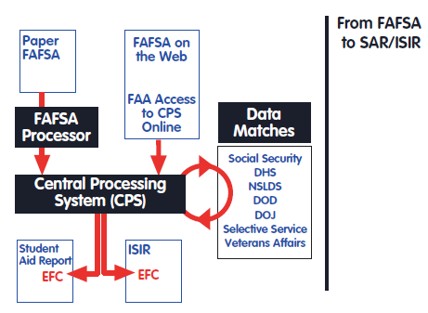
2012-2013 Application and Verification Guide
Released by DOE in March.
Read entire Guide as soon as it is released.
Notes and examples in the margins are important. *Health Account Savings Deduction – Line 25 of 1040
Review EFC Calculation Worksheets – Recommend completing a hand calculation each year.
http://www.ifap.ed.gov/ifap/byAwardYear.jsp?type=fsahandbook

Slide 97
Online Resources
Suggested Bookmarks:
  e-CFR – TITLE 34--Education
    http://ecfr.gpoaccess.gov/cgi/t/text/text-idx?c=ecfr&tpl=/ecfrbrowse/Title34/34cfr668_main_02.tpl
  Application and Verification Guide
    http://ifap.ed.gov/ifap/byAwardYear.jsp?type=fsahandbook&awardyear=2011-2012
  Information for Financial Aid Professionals (IFAP)
    http://www.ifap.ed.gov/
  Publication 17 – Your Federal Income Tax
    Tax Guide for Individuals http://www.irs.gov/pub/irs-pdf/p17.pdf
    IRS Forms and Publications http://www.irs.gov/formspubs
  Tax Transcripts
    http://www.irs.gov/faqs/faq/0,,id=199557,00.html
  USCIS – US Citizenship and Immigration Service
    http://www.uscis.gov/portal/site/uscis
  NSLDS
    https://www.nsldsfap.ed.gov/nslds_FAP/
  Selective Service Registration Confirmation
    https://www.sss.gov/RegVer/wfVerification.aspx
  Social Security Administration
    http://www.ssa.gov/ssnumber/

Slide 98
Thank you for attending!
Any Questions??
you for attending!
Any Questions??
Contact Information:
JoEllen Soucier – jsoucier@proed.org
978-895-0639 www.proed.org

