Slide 1

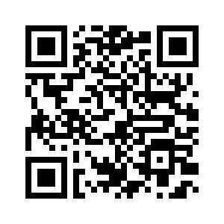


STUDENT SENATE/TRUSTEE
POSITIONS OPEN
APPLICATIONS
DUE 4/25
VOTE
April 27-28
MAKE A DIFFERENCE
Elections ballot will be e-mailed to students
RUN FOR
STUDENT GOVERNMENT
For questions regarding the positions or process, contact adriennevictor@sunyorange.edu

